Slide 1
Harald Uhlig “Economics and Reality” J. of Macroeconomics 2012
Examines 4 points of view:
Economics is a science.
Economics is an art.
Economics is a competition.
Economics is politics.
Examines specific cases for illustration and debate:
Is there a Phillips curve?
Are prices sticky?
Does contractionary monetary policy lead to a contraction in output?
What causes business cycles?

Slide 2
1. Economics is a Science
Theory-led deductive approach
Derive falsifiable predictions from a prior hypothesis
(Popper (1934))
Vs.
Empirically-grounded inductive approach
Derive theoretical principles from careful observation
Uhlig conclusion: Reality does guide economics. Empirical evidence influences and should influence economics, as in any scientific discipline, but there is not a single successful approach to do so.

Slide 3
2. Economics is an Art.
Economists should not try to construct a “Theory of Everything.”
Occam’s razor: The hypothesis with the fewest assumptions able to explain a given set of facts must be the correct one.
“Beware of theorists bearing free parameters.” (Goldberger and Lucas)
A good theory is false by design. The key is to summarize key facts that a good – and therefore minimalistic – theory is meant to capture.
Uhlig conclusion: Reality influences economic thinking by guiding theorists to design beautiful, minimalistic theories that connect to a select set of key facts.

Slide 4
3. Economics is a Competition of Ideas
How do economist decide which direction of research is correct, which line of inquiry is fruitful, which argument is convincing?
McCloskey: Economics is rhetoric.
Old theories are never really discarded. Economists love to hang on to beliefs once formed.
Uhlig conclusion: New theories predict or explain new facts. Nonetheless, old theories stay around, whether they explain existing new and old facts or not.

Slide 5
4. Economics is Politics
“Practical men, who believe themselves to be quite exempt from any intellectual influence, are usually the slaves of some defunct economist.” (Keynes, 1936, Ch. 24)
There is a competition of ideas in practical politics as well.
Uhlig concludes that “economic thinking at the practical level of economic policy is thick-skinned and conservative. It is rarely influenced by fresh economic theory or by fresh empirical evidence, unless it fits well with an agenda that had been established elsewhere already.”

Slide 6
1. Is there a Phillips Curve?

Slide 7
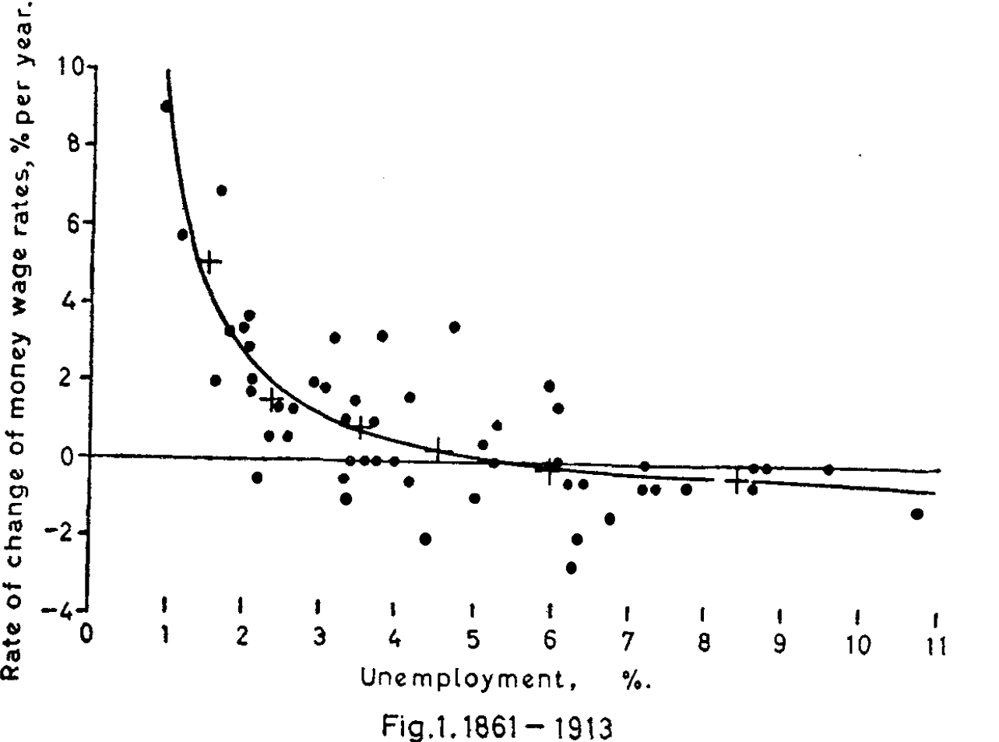
Phillips (1958)

Slide 8
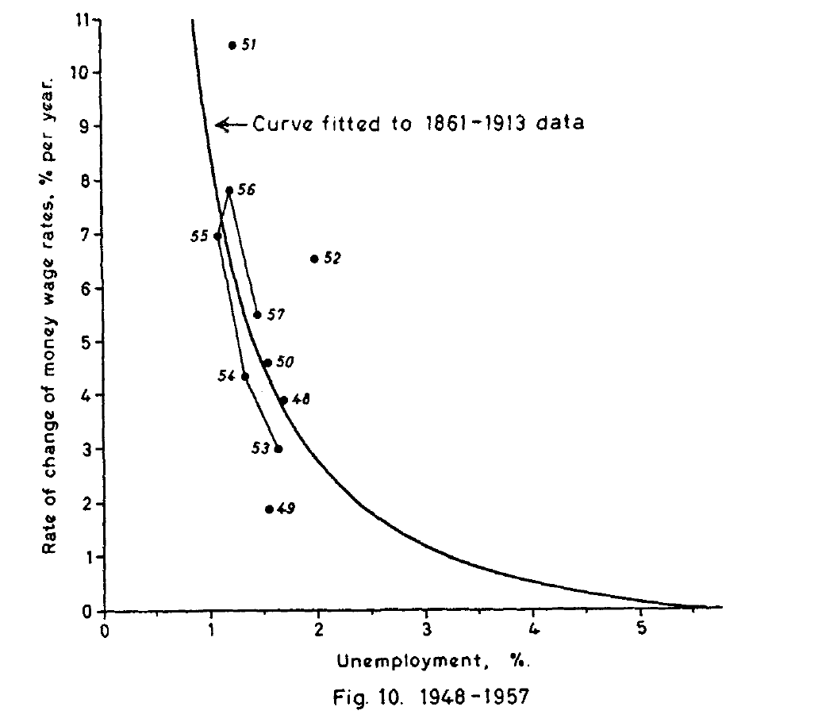

Slide 9
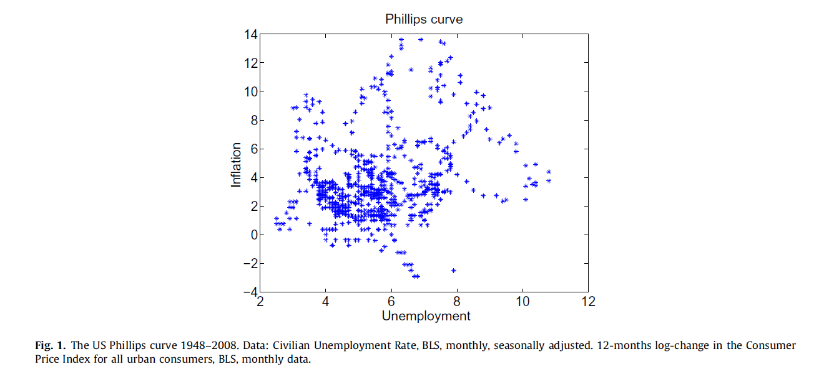
Uhlig (2012)

Slide 10
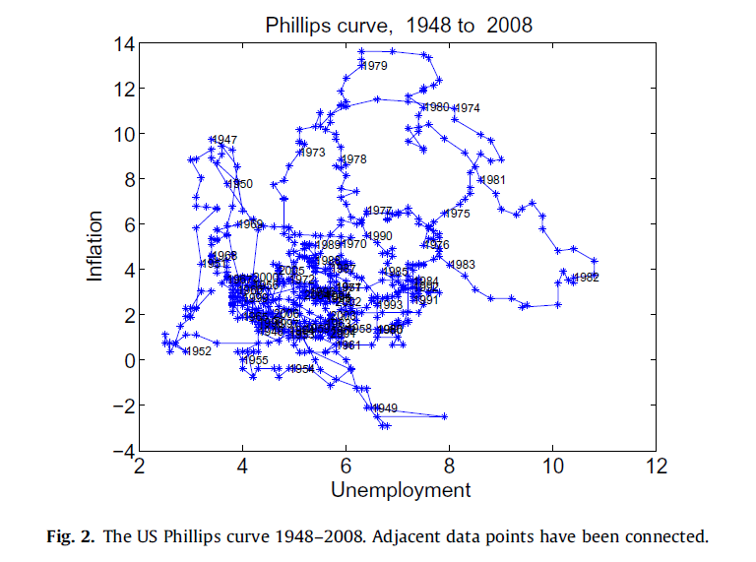

Slide 11
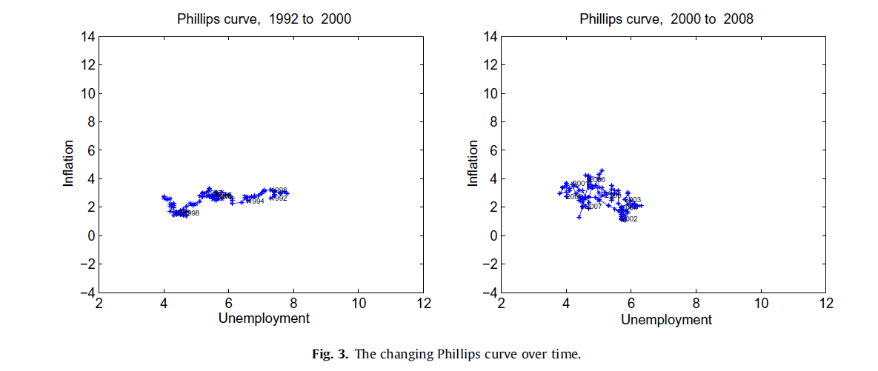

Slide 12
2. Are prices sticky?

Slide 13
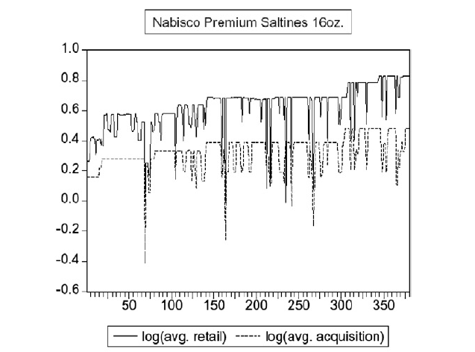

Slide 14
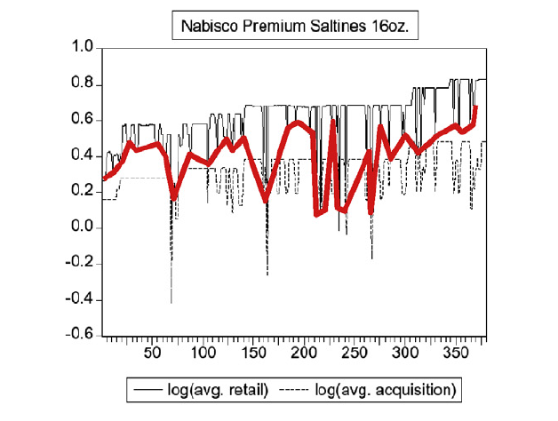

Slide 15
3. Does contractionary monetary policy lead to a contraction in output?

Slide 16
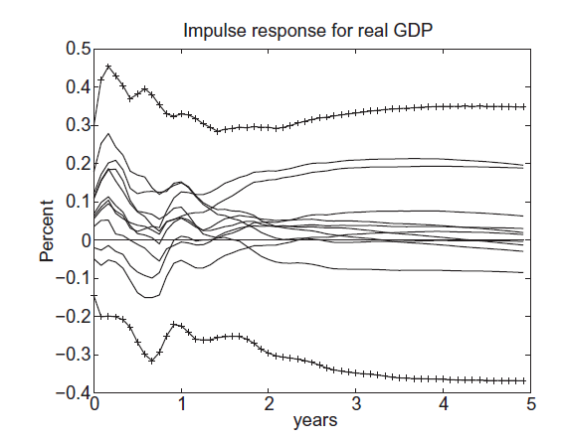
Effect of a positive shock to the fed funds rate
(sign restrictions constrain the price response to be non-negative .)

Slide 17
4. What causes business cycles?

Slide 18
