Slide 1
The Perils of Identification in Macroeconomics:
Potential Pitfalls and an Extended Example
By Valerie A. Ramey

Slide 2
Applied Microeconomics Point of View
Angrist and Pischke (2010) – econometric revolution in applied micro
Macroeconomics is lagging behind on econometric revolution.
In Macroeconomists’ defense, these issues tend to be much harder because of (i) general equilibrium considerations; (ii) the importance of dynamics; and (iii) the importance of expectations.
However, I think we can still learn a lot from the econometric revolution in micro.

Slide 3
I will use examples from estimating government spending multipliers

Slide 4
How Do We Estimate the Government Spending Multiplier Relevant for a Short-Run Stimulus Package?
Ideally, the IMF would run a randomized trial:
It would randomly assign a large group of countries to treatment and control groups.
In the treatment group, government spending would be increased for 2 years starting immediately and would be financed by deficit spending. The government would commit to a future increase in tax rates to finance the deficit.
After 2 years, the IMF economists could use Diff-in-Diff methods to analyze the data.

Slide 5
How can we reproduce a randomized trial in aggregate time series data?
Treatment Group - quarterly or country-year observations in which government spending changes.
Control Group – all other quarterly or country-year observations
(we can also call this the “counterfactual”)
Random Assignment - to mimic random assignment, we need to:
- Identify unanticipated, “exogenous” shocks
- Include control variables so that we compare to the right counterfactual given the dynamics of the economy.

Slide 6
Empirical Challenges in Estimating Effects in
Nonexperimental Data
Identification
  1. Exogeneity
  2. Relevance
  3. Surprises
Counterfactuals
Robustness and sensitivity

Slide 7
A. Identification
Identification is at the heart of every empirical effort that is not simple data description.
Identification:
turns correlations into causal relationships
is achieved by applying theoretical assumptions to data

Slide 8
A. Identification (cont.)
Consider the classic case of trying to identify demand parameters using data on price and quantity of strawberries.
2 ways to identify the demand parameters:
Identification using additional data: Find additional variables that theory tells us enters the supply curve but not the demand curve, such as rainfall.
Structural Identification: Use outside estimates or assume the form of the supply curve, impose these parameters on the data and then estimate the demand curve parameters.

Slide 9
Some Issues in Identification
Instruments must be exogenous.
  Note that exogeneity must always be defined relative to the model.
  Is the instrument uncorrelated with the error term in the structural equation?

Slide 10
Typical Ways that Macroeconomists Achieve Identification
Structural identification
  Specify a full DSGE model, make assumptions on the types of shocks and their serial correlation properties, and then estimate the parameters and simulate (Cogan et al (2009)).
Standard VARs achieve identification through timing assumptions.
  Blanchard-Perotti (2002) identify government spending shocks using a Choleski decomposition, ordering government spending first.
Structural VARs (SVARS) bring in outside information.
    Blanchard-Perotti (2002) identify tax shocks using institutional information on the endogenous part of taxes and transfers.

Slide 11
Typical Ways that Macroeconomists Achieve Identification
4. Intuitive arguments
  Hall (1980, 1986) and Barro (1981) argued that military spending represents an exogenous shocks to the economy.
5. Narrative Methods
  Romer-Romer (1989), Ramey-Shapiro (1998), Ramey (2011) use narrative methods to identify news about increases in military spending.

Slide 12
Example in which Narrative Methods Don’t Necessarily Solve the Exogeneity Problem
Romer and Romer (1989) used the narrative approach to identify dates at which Fed decided to reduce inflation.
They took this as an exogenous shock to policy and then studied the effects.
We now know that they were estimating the reaction part of policy, not an exogenous shock.
i_{t} = .04 + 1.5(π_{t} - .02) + 0.5(y_{t} – ybar_{t})
In fact, Shapiro (1994) showed that the dates were predictable from expectations about future unemployment and inflation:

Slide 13
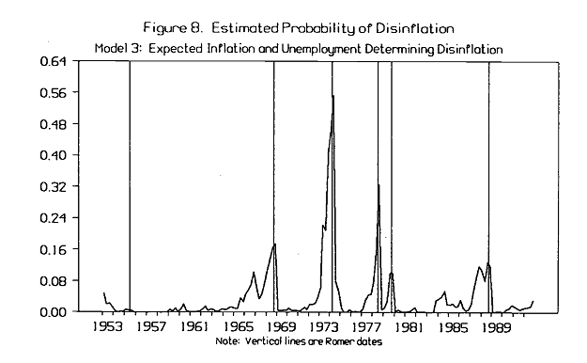
From Shapiro (1994)
“Federal Reserve Policy: Cause and Effect”
Thus, these dates can’t be used to answer the question: What is the independent effect of the Federal Reserve raising interest rates?

Slide 14
Application to the Fiscal Context
Most identification methods have difficulty capturing expectations about the future
These expectations are key to determining when and how policy makers act.
A recent IMF study on fiscal consolidations uses a narrative approach, but doesn’t take into account the endogeneity of the decision to undertake a fiscal consolidation.
Consider the following evidence offered by Krugman that fiscal consolidations lower GDP growth:

Slide 15
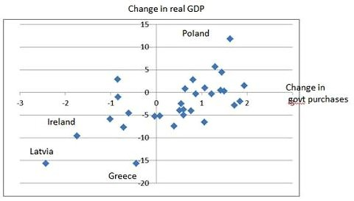
Krugman’s evidence for high multipliers

Slide 16
Reasons Why Fiscal Consolidations May be Correlated with Slow Growth
Bad leadership: Past legislation lines the pockets of cronies, distorts economic incentives, raises the deficit, and leads to decreased productivity.
Demographics: An increase in the fraction of the population that is older (1) decreases labor supply growth, and hence output growth; (2) increases transfer payments and decreases tax revenues; (3) causes resources to shift to one of the most distorted and inefficient sectors of the economy (health care).
Growth Slowdown: Government tax and transfer programs may have been set up assuming high growth. It takes awhile for politicians to realize the growth slowdown is not temporary. In the meantime, the deficit increases.
Thus, the action taken may be correlated with the error term, so the instrument may not be exogenous.

Slide 17
More Issues in Identification
2. Instruments must be relevant.
Most macroeconomists understand the exogeneity requirement, but few seem to aware of the importance of relevance. Work by Bound, Jaeger, Baker (1995) and Staiger-Stock (1997) show how far wrong you can go if your instruments have low relevance.
Even with gigantic data sets, (Angrist-Krueger had 330,000 observations), the IV will be severely biased towards OLS if the first-stage F-statistic is low.
Rule-of-thumb: if the first-stage (marginal) F-statistic on your instruments is less than 10, you may have instrument relevance problems.

Slide 18
Examples from Fiscal Empirical Work
Virtually any shock identified by a standard VAR will have a high first-stage F-statistic, since the shock is defined as the difference between the variable and its projection on lagged values of itself and other variables.
Other types of instruments:
Variable that is instrumented | Instrument and sample | First-stage F-statistic
government spending | Ramey news, 1947:1 – 2010:4 | 19.75
government spending | Ramey news, 1958:1 – 2010:4 | 1.40
government spending | Fisher-Peters stock returns, 1958:1 – 2008:4 | 2.51
government tax receipts | Romer-Romer exogenous tax variable | 7.64
All regressions include 4 lagged values of endog variable, GDP, employment, treasury bill rate, Barro-Redlick avg. marginal tax rate.

Slide 19
Some Issues in Identification
3. The identified shocks must be unanticipated.
This was the whole point of my recent QJE paper “Identifying Government Spending Shocks: It’s All in the Timing.”
I showed that most movements in government spending are anticipated and that failing to incorporate that in a VAR can dramatically change the results.
Also, the work by Leeper, Walker, and Yang works out the econometrics when there is foresight about tax policy.

Slide 20
B. Counterfactuals - getting the control group right
We want to compare the path of the economy after government spending has increased to what would have happened if government spending hadn’t increased.
The typical way to capture the counterfactual is to run an SVAR (using Choleski, narrative, etc.) and include lagged values indicating the state of the economy, such as GDP, hours, interest rates, taxes.
The impulse response functions then compare what happens after a shock to government spending to what would have happened had government spending not changed relative to its past.

Slide 21
Think about counterfactuals in a less subtle setting:
Measuring the Effect of Going to the Hospital
Question: What is the effect of going to the hospital on the probability of dying in the next 6 months?
Method: compare individuals who show up at the emergency room to those who don’t.
Controls: body temperature, blood pressure, and pulse rate.
Comparison: death rate of “treatment group” vs “control group” (those who didn’t go to the hospital).
Result: People who went to the hospital were more likely to die than those who didn’t go to the hospital
Would you refuse to go to the hospital because of this study?
Let’s consider a similar recent instance of counterfactual problems:

Slide 22
From Christina Romer and Jared Bernstein, January 2009
Actual

Slide 23
C. Robustness and Sensitivity
Theory can only guide us so far, so we often must make decisions on which theory doesn’t provide enough guidance – detrending, number of lags, which control variables to include, how to compute the multiplier. We need to check sensitivity of results to these elements.
Always plot both the raw data and the partial correlations so you can detect influential observations and outliers.
But do all these issues really matter in practice?
Notes:
I used to think that applied microeconomists were going over-board. I thought that sometimes they were coming up with reasons why the instrument might not be exogenous as a game.

Slide 24
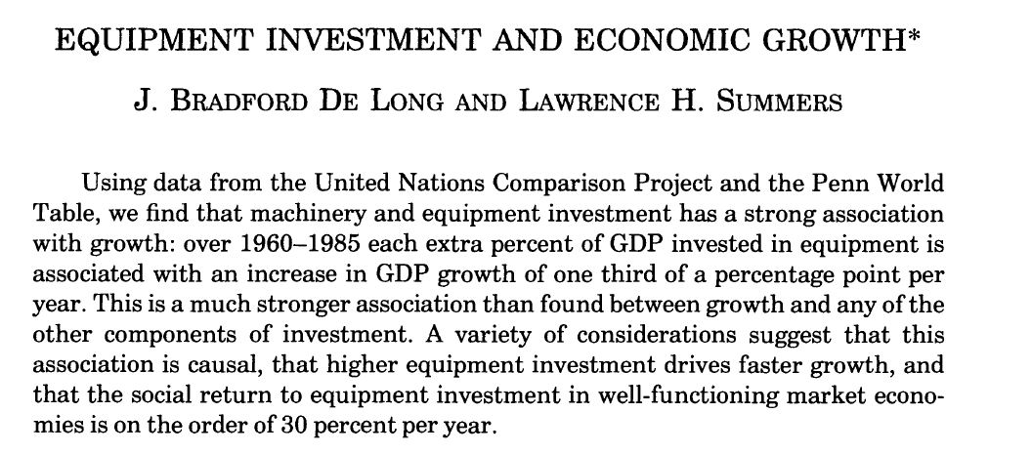
QJE May 1991
Also published extended work in Brookings in 1992

Slide 25
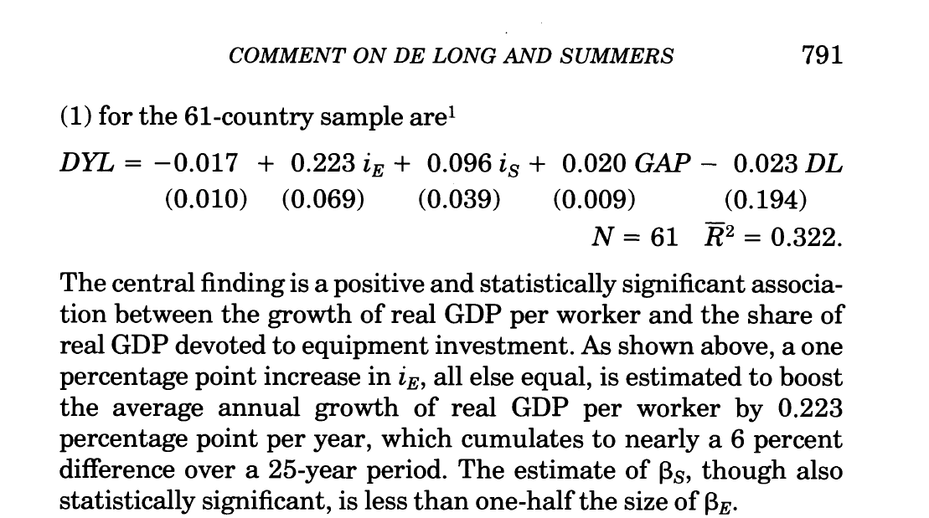

Slide 26
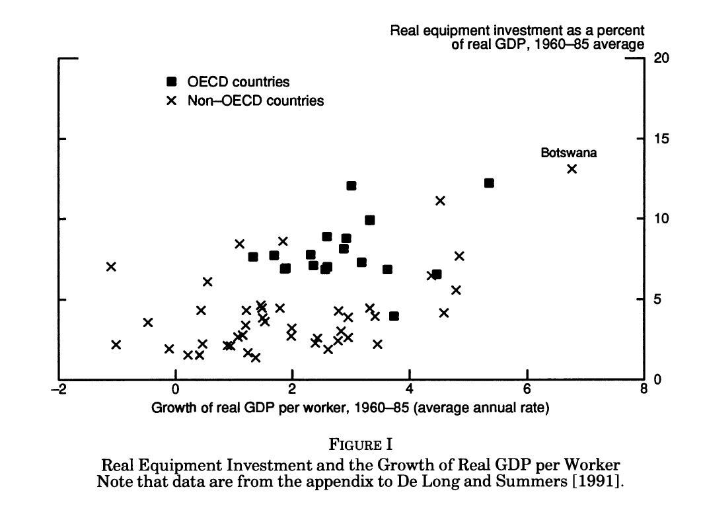

Slide 27
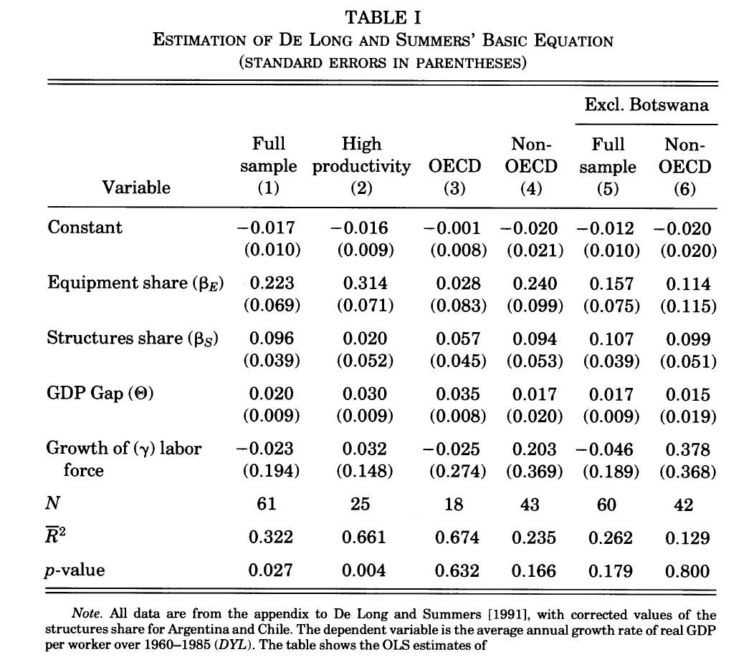

Slide 28
An Extended Example from My Own Work or
“Why I joined the instrument police”
Notes:
I used to think that applied microeconomists were going over-board. I thought that sometimes they were coming up with reasons why the instrument might not be exogenous as a game.

Slide 29
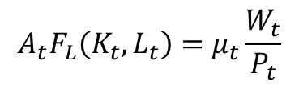
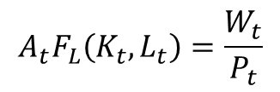
Extended Example
Background: A key controversy is the effect of government spending on real product wages – important for understanding transmission mechanism.
  Neoclassical model predicts that if K doesn’t adjust right away, ↑ G → ↓ real wages since labor supply increases and there are diminishing returns to labor in the short-run.
  New Keynesian countercyclical markups can overcome this effect.
  The empirical results are mixed – Narrative methods find that aggregate real wages fall, Blanchard-Perotti methods find that they rise.
$$A_{t}F_{L}\left(K_{t},L_{t}\right)=\frac{W_{t}}{P_{t}}$$
$$A_{t}F_{L}\left(K_{t},L_{t}\right)=μ_{t}\frac{W_{t}}{P_{t}}$$

Slide 30

Perotti’s Industry Analysis
In his 2008 NBER Macroeconomics Annual paper, Roberto Perotti asks what happens to real product wages in industries that experienced the greatest increases in military spending during the Vietnam and Carter-Reagan buildups.
He uses input-output tables to link both direct and indirect government spending to industries (1963 - 1967, 1977 - 1982).
Perotti ranks industries by the value of $\frac{G_{it}−G_{it−5}}{Y_{it−5}}$, where G_{it} is industry i’s shipments to the government in year t and Y_{it-5} is industry i’s total shipments in the initial year.
Perotti examines the top 10 industries in each buildup and notes that real wages rose in 8 of 10 of the industries. He concludes that ↑G → ↑ W/P, contrary to neoclassical.

Slide 31
Assessment
Perotti’s idea of using input-output tables to derive industry-level government spending is terrific. (Extends an older idea by John Shea (1993).)
However, there are several questions we should ask about the empirical implementation:
  What is the counterfactual?
  Are the instruments relevant?
  Are the instruments exogenous? In other words, are industry-level government spending shifts uncorrelated with industry technology?

Slide 32
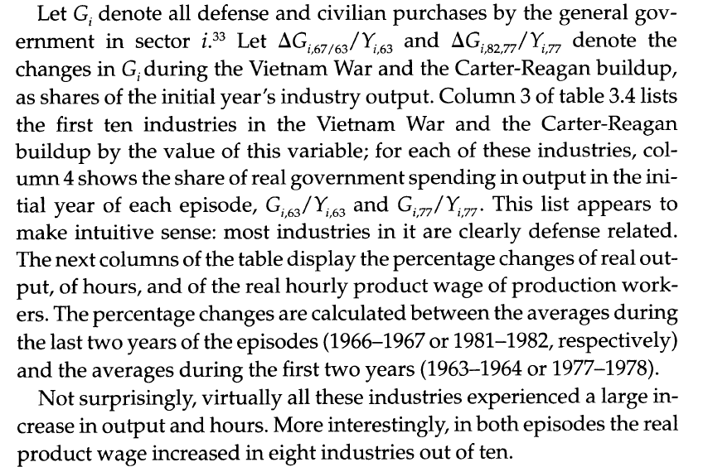
Problem with the Counterfactual
Perotti’s Logic: if ΔL > 0 & Δ(W/P) > 0 in industries with greatest ↑ G from either 1963-1967 or 1977-1982, then neoclassical model is false.

Slide 33
Log Change during Vietnam War
1963-67 (red means rejects neoclassical model)
Industry | Hours | Real wage
Ammunition, excl sm. | 116.9 | -1.8
Small arms ammun. | 101.7 | 9.6
Oth. Ordnance | 41.5 | -4.2
Small arms | 59.6 | 6.9
Semiconductor | 42.6 | 44.9
Electronic nec | 31.8 | 25.8
Watches | 18.9 | 9.8
Paving mix | 17.6 | 22.4
Architec metal | 19.8 | 10.0
But what if we compare it to average labor productivity growth from 1958-1973?

Slide 34
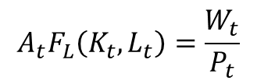
Problem with the Counterfactual
Perotti’s implicit counterfactual assumption is that real wages would not have risen if government spending had not risen since he is comparing Δ(W/P) to a 0 threshold. Consider the first-order condition again:
Perotti was implicitly assuming that A and K were unchanged over these 4 or 5 year periods. In fact, from 1958 – 1973, average annual growth in economy-wide labor productivity was 3% per year. For 1973-1996, it was 1.5%.
$$A_{t}F_{L}\left(K_{t},L_{t}\right)=\frac{W_{t}}{P_{t}}$$

Slide 35
Log Change during Vietnam War
1963-67 (green means consistent with neoclassical model)
Industry | Hours | W/P – 12% | K
Ammunition, excl sm. | 116.9 | -14.2 | 3.7
Small arms ammun. | 101.7 | -2.83 | 11.8
Oth. Ordnance | 41.5 | -16.6 | 23.4
Small arms | 59.6 | -5.5 | 28.4
Semiconductor | 42.6 | 32.5 | 45.5
Electronic nec | 31.8 | 13.4 | 64.2
Watches | 18.9 | -2.6 | 12.4
Paving mix | 17.6 | 10.0 | 16.3
Architec metal | 19.8 | -2.4 | 21.0

Slide 36
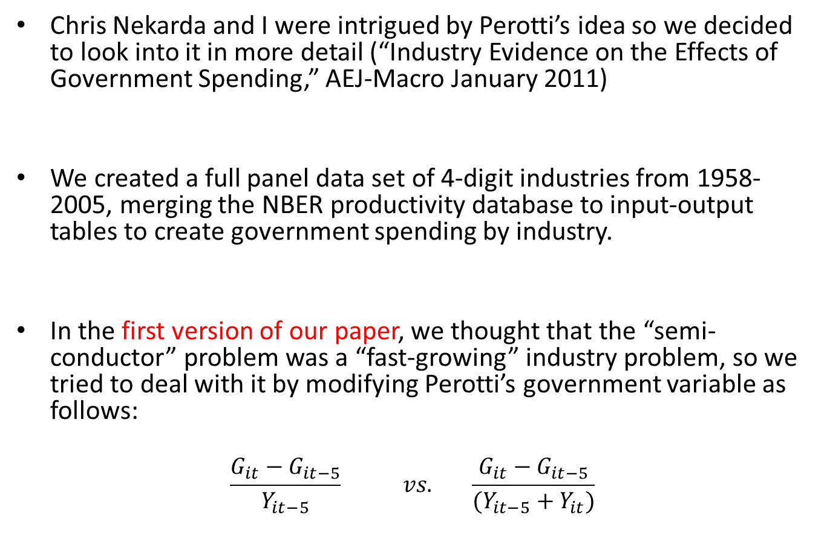
Nekarda-Ramey Empirical Analysis
Chris Nekarda and I were intrigued by Perotti’s idea so we decided to look into it in more detail (“Industry Evidence on the Effects of Government Spending,” AEJ-Macro January 2011)
We created a full panel data set of 4-digit industries from 1958-2005, merging the NBER productivity database to input-output tables to create government spending by industry.
In the first version of our paper, we thought that the “semi-conductor” problem was a “fast-growing” industry problem, so we tried to deal with it by modifying Perotti’s government variable as follows:
$$\frac{G_{it}−G_{it−5}}{Y_{it−5}} vs. \frac{G_{it}−G_{it−5}}{(Y_{it−5}+Y_{it})}$$

Slide 37
Nekarda-Ramey Empirical Analysis
We controlled for the counterfactual by including both industry- and time- fixed effects – thus we were comparing the changes in the variables relative to the average in other industries.
Our modified government demand variable, like Perotti’s initial variable, had first-stage F-statistics over 100 for explaining industry output and hours, so both were very relevant.
However, regressions showed that both our modified variable and Perotti’s variable implied industries with greater growth of shipments to the government experienced faster than average labor productivity growth. We thought we had found evidence of increasing returns.

Slide 38
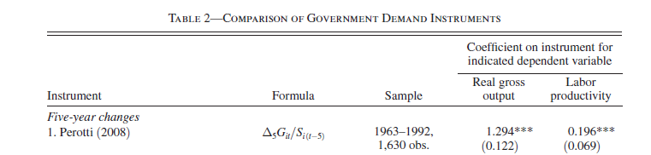
Nekarda-Ramey Empirical Analysis
The real gross output column results show the high first stage F–statistic
(112).
But the last column results imply that a demand shock that raises output by 10% raises labor productivity by 1.5%.
This suggests increasing returns!

Slide 39
Nekarda-Ramey Empirical Analysis
Critique during my UC Irvine Seminar: Perotti’s instrument is valid as a demand instrument only if the distribution of government spending across industries is uncorrelated with technology.
- Gary Richardson examples
- Min Ouyang suggestion (also known as “Bartik instruments”)
Chris and I studied Min’s suggestion by algebraically decomposing the instrument into a part that could depend on technology and a part that could not.

Slide 40
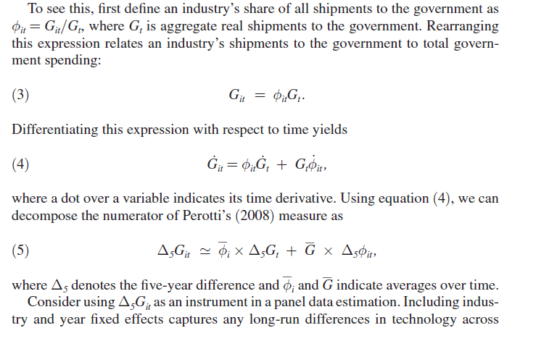
Nekarda-Ramey Empirical Analysis

Slide 41
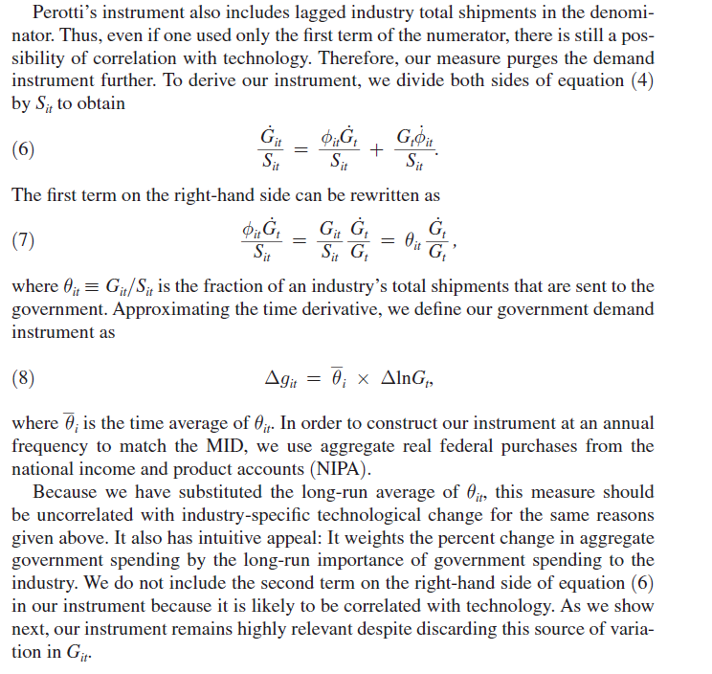

Slide 42
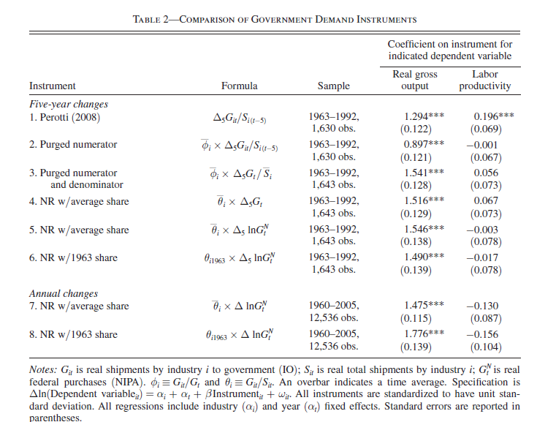
Nekarda-Ramey Empirical Results

Slide 43
Nekarda-Ramey Empirical Results
Our purged instrument was still very relevant
First-stage F-statistics above 100.
IV regressions with the purged instrument produced estimates suggesting that an increase in output or hours caused by government spending led to:
- small declines in labor productivity
- small declines in real product wages
- rises in the capital stock
- roughly constant returns to scale
Thus, the previous findings of increases in productivity and real wages were in part due to the fact that Perotti’s instrument wasn’t exogenous – it was correlated with technology.

Slide 44
Conclusions from this Exercise
It is important to get the counterfactual right.
It is a good idea to look for outliers and influential observations.
Constructing demand instruments that are correlated with technology will lead to the wrong answers.

