Slide 1
Reference-dependence and loss-aversion
Colin Camerer Caltech
RES Easter School 22-25 Mar 2015
Nearby objects (space, or time) often affect perception or valuation of a target stimulus
Neural and psychological effects
  Normalization, adaptation and contrast
Effects on valuation and choice
  Reference-dependence
  Context-dependence (“menu effects”)

Slide 2
1 Normalization
Neuron firing rates are biophysically constrained
  Non-negative (“rectified”)
  Refractory periods (recharge)
  metabolically costly
Implication:
  Neural firing rates should adjust to reflect useful information best

Slide 3
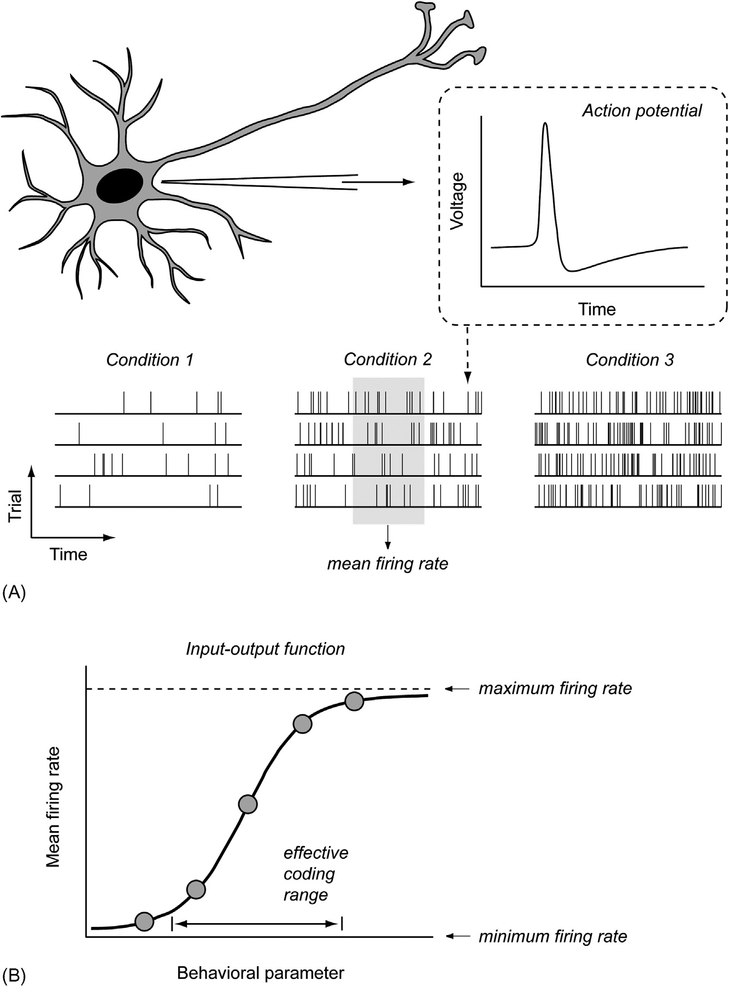
Notes:
From L-DM chapter 24

Slide 4
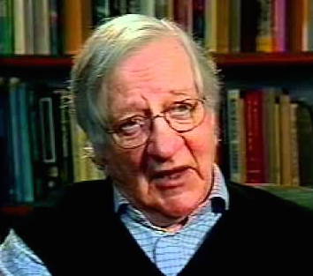
Efficient coding hypothesis
(Barlow 1961)
Sensory systems adjust responses
to statistical properties of inputs
Goal: Focus scarce sensory coding where the variation is
a/k/a “[information] gain control”
E.g. retinal adjustment enables seeing at a wide variety of light levels…rapidly
How?
Cf. Woodford 2012 etc.
Notes:
Picture and quote
http://i.ytimg.com/vi/cv9hje42i_E/hqdefault.jpghttp://i.ytimg.com/vi/cv9hje42i_E/hqdefault.jpghttp://i.ytimg.com/vi/cv9hje42i_E/hqdefault.jpg
Link to rational inattention
Woodford 2012: The theory is similar to the “rational inattention” hypothesis of Sims (1998, 2003, 2011), but modified for closer conformity with psychophysical and neurobiological evidence regarding visual perception.

Slide 5
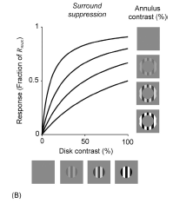
Divisive normalization
Neural firing is normalized based on input and inputs to a (nearby) “normalization pool”
R_{i} = R_{max}(D_{i}^{n})/( σ^{n} + Σ_{k} D_{k}^{n}) parameters σ,n
Notes:
Fig from KL-BDM chapter
Look up Louie, Grattan Glimcher J N 2011

Slide 6
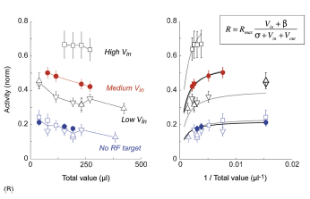
Evidence of normalization by value neurons in LIP (Louie+ JN 2011)
Notes:
Activity reduced by value in targets outside the receptive field (RF) (decling curve on left…fit by model on right)
Also seen in reach areas ^{Pastor-Bernier} Cisek 11)

Slide 7
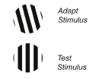

2 Adaptation
Local contrast effects (e.g. perceptual)
Adaptive coding of percepts based on mean and range
contrast adaptation (fixate top 30s…)

Slide 8
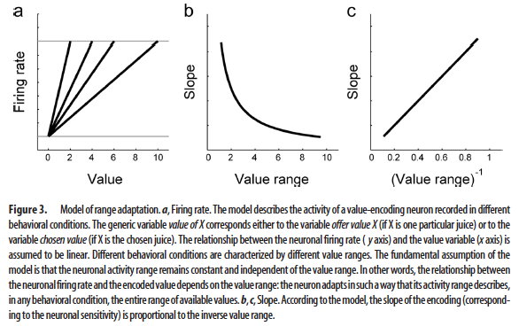
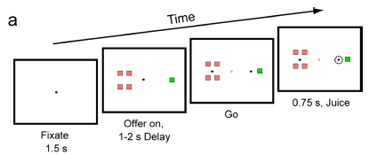
Adaptive coding in monkey OFC (Padoa-Schioppa JN 09)

Slide 9
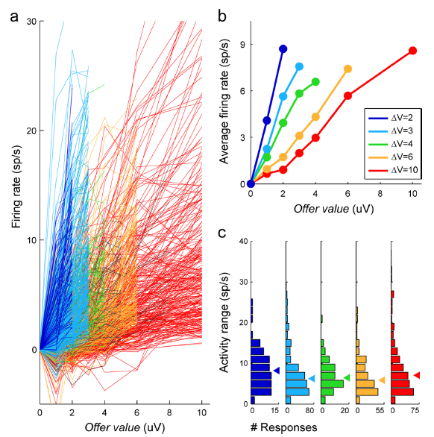

Slide 10
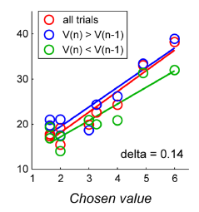
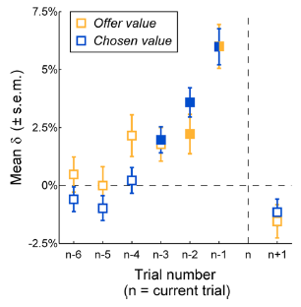
Evidence for trial-by-trial adaptation
Notes:
If V(n) offer is above v(n-1) should fire more … can see influence of last 3-4 trials

Slide 11
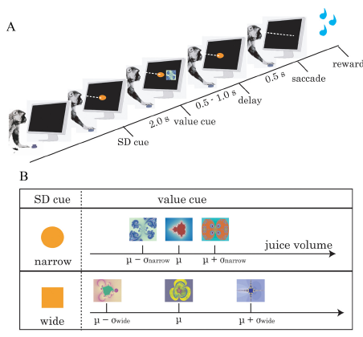
How rapidly does adaptation occur? (Kobayashi+ JN 2010)
Notes:
Monkeys see a variation (SD) cue, then outcome cue, must fixate then saccade for reward.
Amounts [animal A; animabel is heaver and got more juice) are (.20, .34, .48) for narrow, (.06, .34, .62) both cases SD(wide)=2SD(narrow)

Slide 12
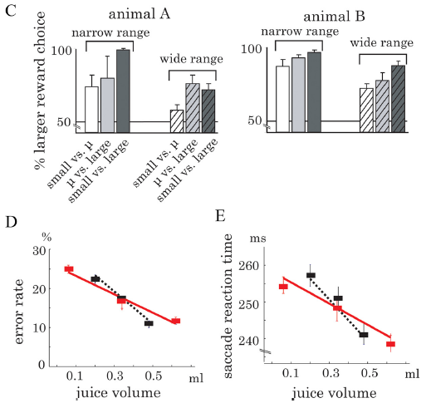
Adaptive coding in choice & RT (more sensitive to rewards in the narrow condition)
Notes:
These results are from a separate two-cue condition (comparing two of the cues in the range) . No recordings are being matched up to these data

Slide 13
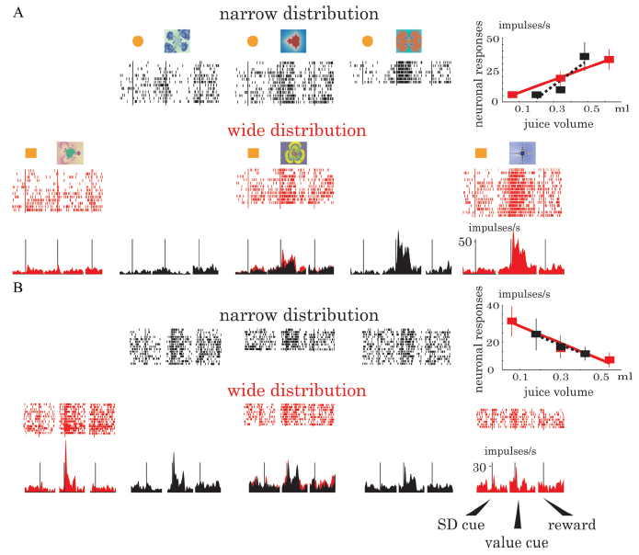
Exemplar neurons that fire adaptively (top) or to absolute reward (bottom)
Notes:
Example neurons( (Kobayashi JN 2010 fig 2)

Slide 14
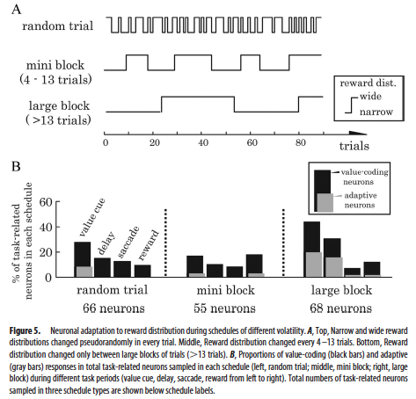
Adaptation neurons more common when there are slow shifts in variance [“large block”]
Notes:
C 8 sec per trial….so blocks are around 60sec. Text: “reward adaptations in the of neurons take time in the order of seconds to tens of seconds..” says DA neurons adapt within 2 secs, much more rapidly.

Slide 15
Is value like perception?
Glimcher Yes:
Padoa-Schioppa (Neuron 13): No
“Upon a closer examination, the two neuronal systems do present important similarities, but also clear differences. First, offer value cells do not show consistent choice probabilities, unlike MT cells. Second, the activity of chosen juice cells does not resemble a race-to-threshold, unlike that of LIP cells (but see above). Third, chosen value cells do not have an obvious analog in perceptual decisions. Consequently, there is no known counterpart for the activity overshooting. Fourth, the encoding of value in the OFC undergoes range adaptation and, more generally, depends on the behavioral context in ways that differ from those found in MT (Kohn, 2007; Padoa-Schioppa, 2009; Padoa-Schioppa and Assad, 2008). Last but not least, neuronal activity in the OFC is nonspatial. In summary, economic decisions appear to involve distinct neuronal mechanisms that cannot be simply equated to those underlying perceptual decisions.”

Slide 16
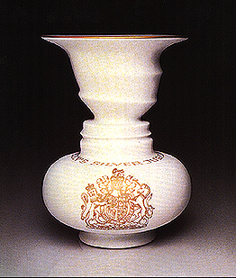
3 Reference-dependence
values often depend on stimulus outcomes compared to a reference point (Kahneman, Tversky Ecma 79)
  Specifically inspired by perceptual contrast
Evidence:
  Behavioral
  Neural (not much)
What are biologically natural reference points?

Slide 17
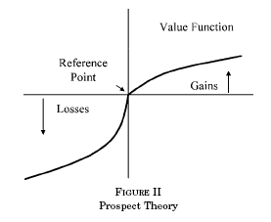
Prospect theory value function:
Note kink at zero (“loss-aversion”) and diminishing marginal sensitivity (concave for x>0, convex for x<0)

Slide 18
“Asian disease” problem
Loss frame (22% choose certain)
  200 dead vs 1/3 0 dead
  2/3 600 dead
Gain frame (72% choose certain)
  400 saved vs 1/3 600 saved
  2/3 0 saved

Slide 19
“Myopic” reference-dependence
Requires theory of “mental accounting”
  What choices are integrated?
  When are mental accounts closed/opened?
  (time/space? 9th race effect)
  Choose: a $240 or b 25% $1000
  c -$750 or d 75% -$1000
  84% a, 87% d

Slide 20
Violation of stochastic dominance!
ad 25% +240 75% -760
bc 25% +250 75% -750
Kahneman Tversky J Business 86
Cf. Koszegi-Rabin AER 09

Slide 21
Reference-dependence modeling
Consumption + gain/loss “transition” utility (prediction error?/learning signal?)
What is r?
  Status quo or initial condition
  Lagged expectation
  → “personal equilibrium”
  Decisions are optimal
  Decisions fulfill expectations
  in which decision fulfills expectations (multiple equilibria, endowment effect, Giffen good effects…)
  Solves problem of why r is not chosen to be superlow

Slide 22
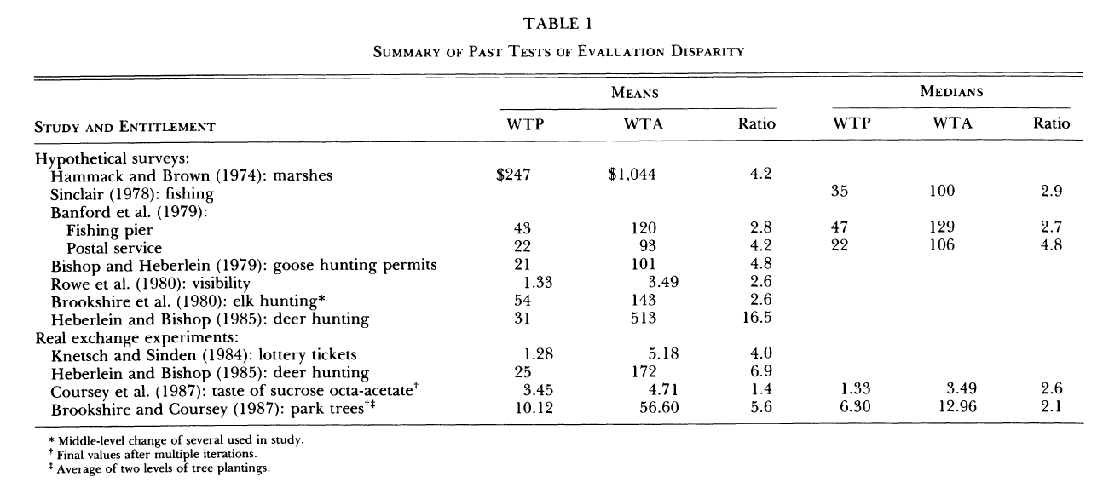
Example: Endowment effects (KKT JPolEcon ’90)
Notes:
GET BETTER EXAMPLE HERE

Slide 23
2a Endowment effects
Original idea
Model
Experience effects (=shift of ref pt?)
Touch
Monkeys
Physical proximity
  Other Pavlovian fx
Query theory

Slide 24
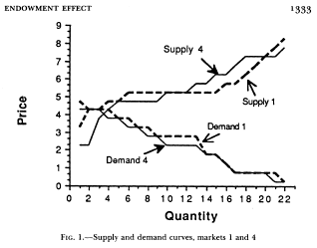
“mugs” experiment (Kahneman+ JPE ‘90)

Slide 25
Instructions eliminate endowment effects?
Plott-Zeiler (AER 06)
Extensive training
“All subjects were handed a mug before the start of the round”
“Best” data from 1st round
mean median std. dev.
Sell N=14 5.71 5.00 4.00
Buy N=12 7.88 6.50 6.00

Slide 26
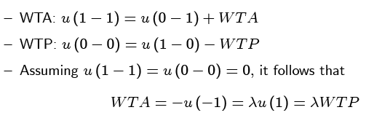
Mug analysis with r=1 for selling, r=0 for buying

Slide 27
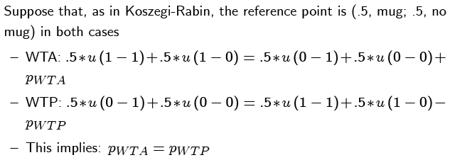
VERY sensitive to reference point: Possible trading erases endowment effect

Slide 28
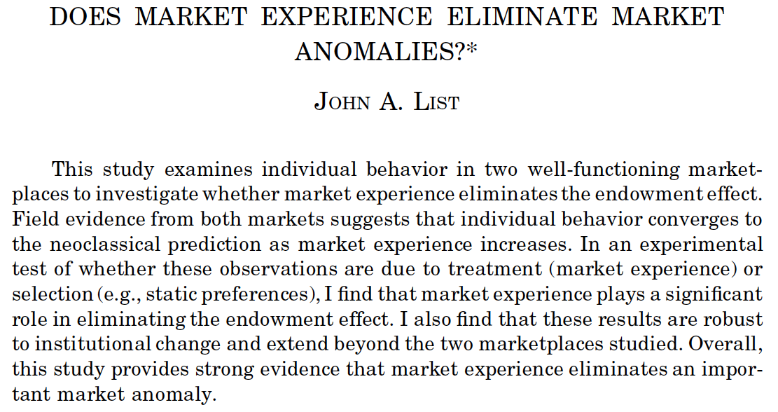
QJE 2003
Notes:
What is meant by market experience? What is meant by “eliminating” ? 769 GS citations 20 March 2015

Slide 29
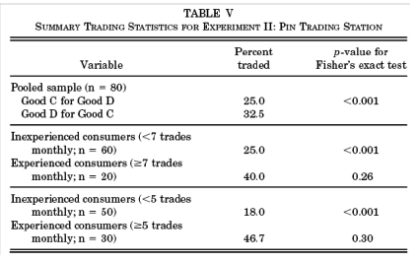
List (QJE 03) trading experience reduces endowment effects
KKT: No endowment effect for “goods purchased for the purpose of exchange or resale”
z=1.3, p=.10
z=2.7, p=.002
Mean 6.98 (13.63)
Notes:
Why not use median split??

Slide 30
Important! Lab experience also reduces endowment effects List (QJE 03)
Engelmann, Hollard Ecma ‘10:
Forced trading → more free trading

Slide 31
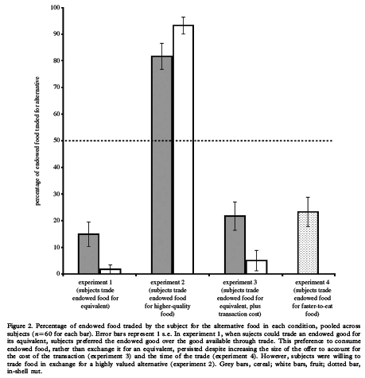
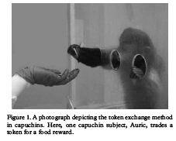
Capuchins exhibit reluctance to trade (endowment fx) (y-axis = % trading)
Santos+PhilTransRoySocB 08

Slide 32
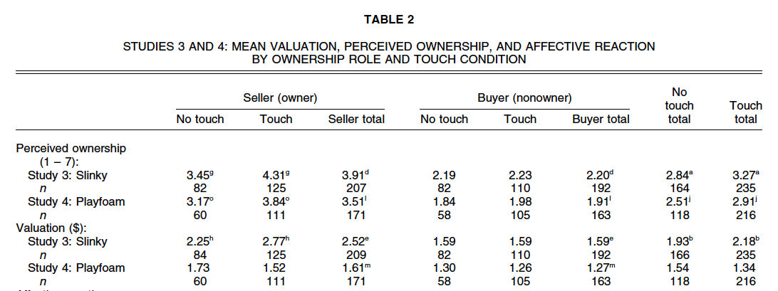
Touch, “own” increase values
Peck, Shu JConsumerRes 09

Slide 33



Physical proximity trumps ownership
Knetsch and Wong JEBO 09
“Owned” but not physically proximate
50% trade
Not owned but physically proximate
23% trade

Slide 34
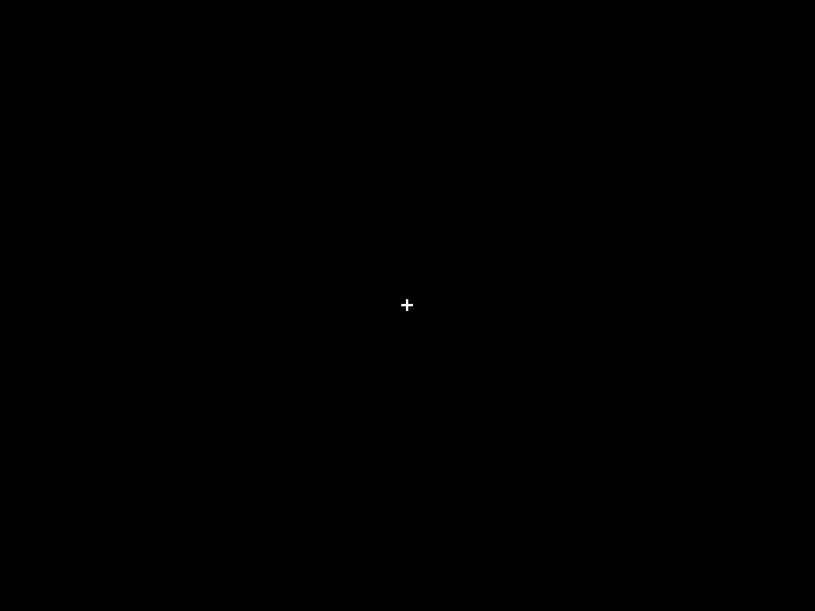

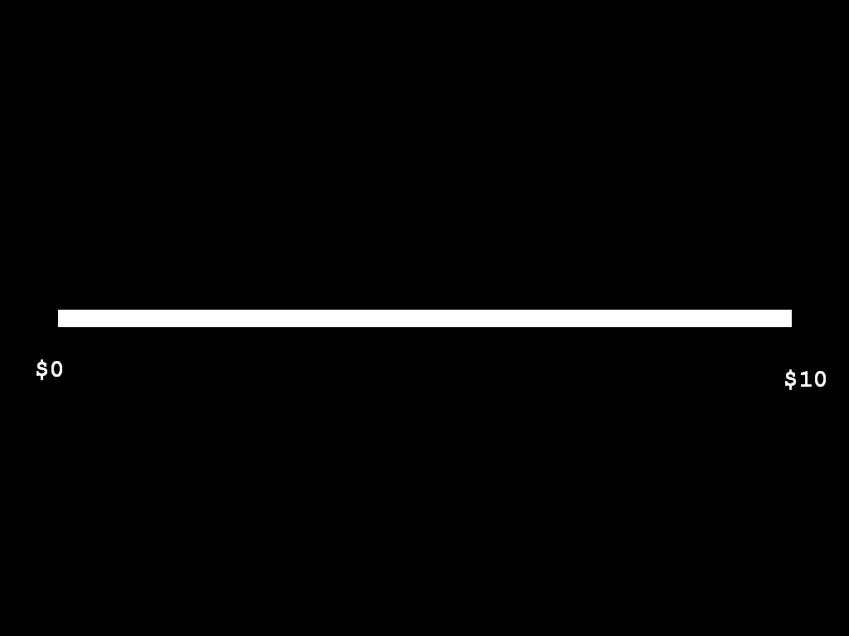

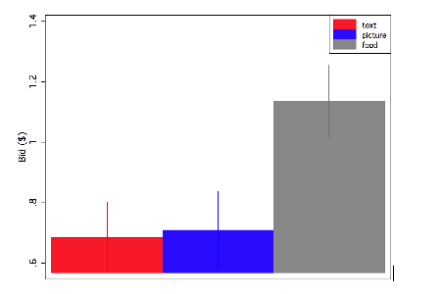

Pavlovian cues and goal values
(Bushong+ AER 2010)
3 display conditions:
2000 ms
3000ms
Unlimited Time
2000 or 4000ms
cheetos
(real thing)

Slide 35
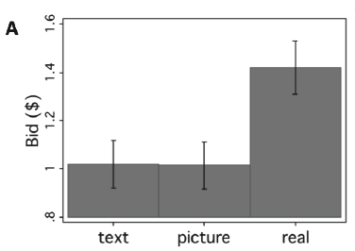
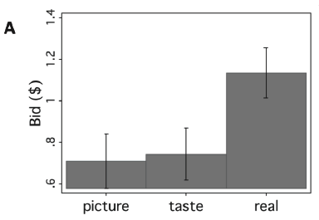
Display difference is not smell (trinkets) or “information” (small taste)

Slide 36
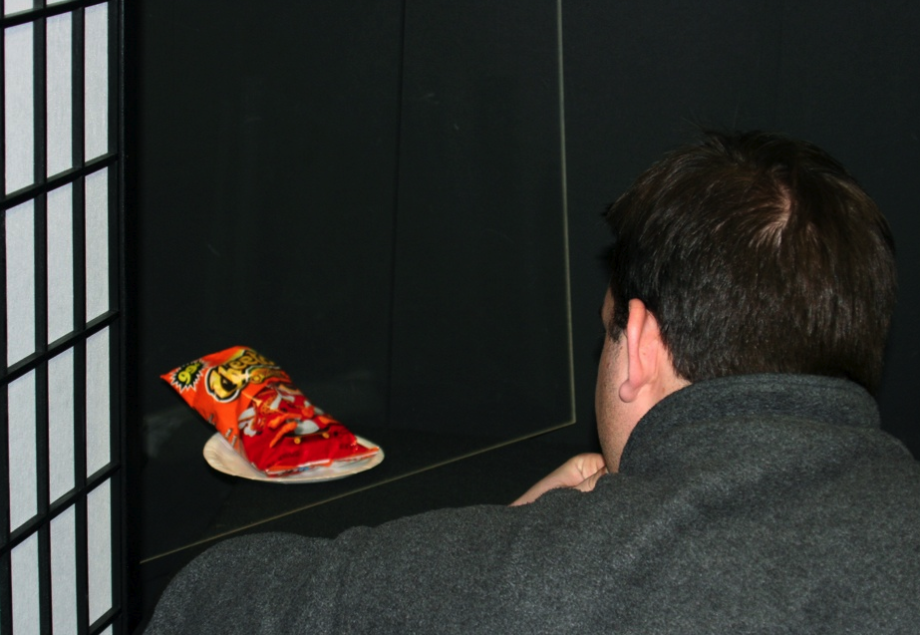

Slide 37
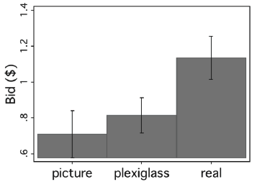
Plexiglass barrier disables Pavlovian cuing

Slide 38
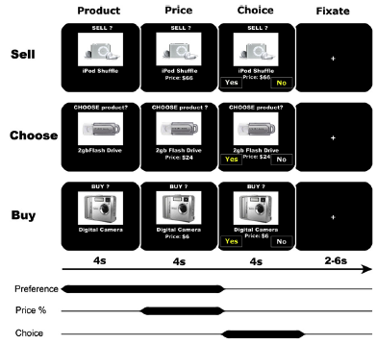
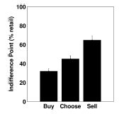
Endowment effects
Knutson+ Neuron 08

Slide 39
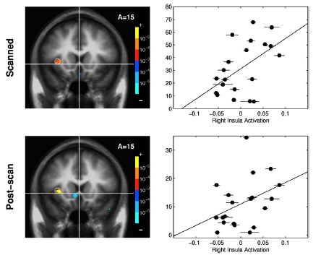
Insula activity sell - buy (x) correlated with endowment effect (y) (con valuation, pro “dislike selling” (no Nacc diff also)
(cf. Barberis-Huang 08) (note y-axis difference in size of selling-buying gap)

Slide 40
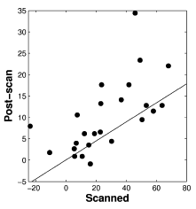
BUT…weak correlation of endowment effect (sell - buy) in fMRI & post-scan

Slide 41
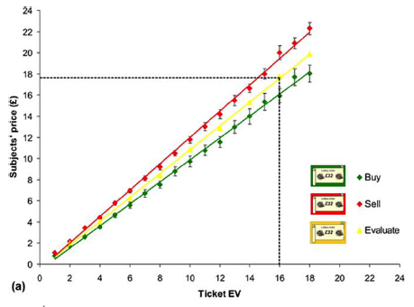
Mild endowment fx for lottery gambles
DeMartino JNeuro 09

Slide 42
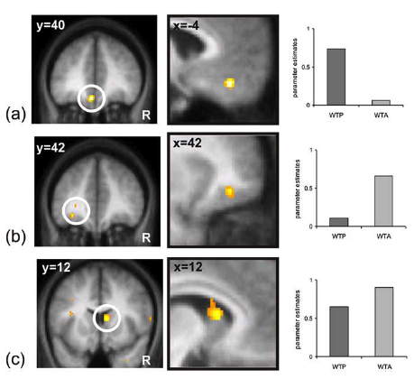
ROIs for buying, selling, both

Slide 43
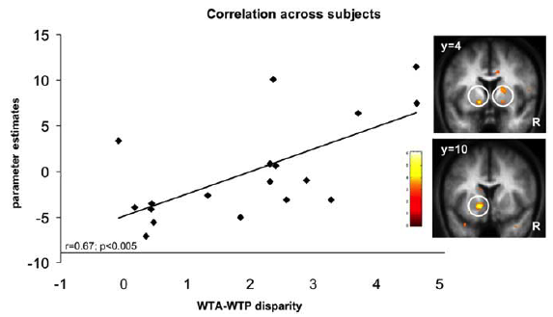
Other evidence for VStr (value) difference in endowment effect
y-axis is GLM beta response to diff-in-diffs (ΔWTA-ΔWTP) (self)-(ΔWTA-ΔWTP) (random)
DeMartino+ JNeuro 09

Slide 44
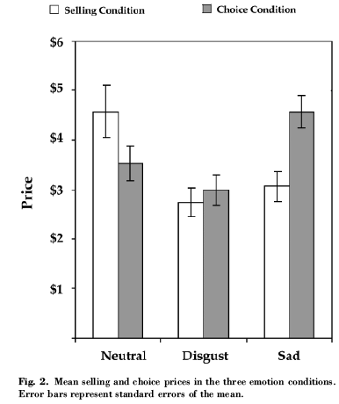
Emotions & endowment fx
Selling (owned)
vs. choice
Sadness --> desire to sell (change)
Disgust --> lowers values in general
Lerner+ PsySci04

Slide 45
What are reference points?
Backward:
  Recent outcome (status quo, current state)
Forward:
  Aspiration or goal (often a round number)
  Endogeneous “personal equilibrium”
    Expectations are confirmed by choice (“rational”)
    Reference point is what will be chosen
    Not highly plausible neurally
New answer: They are determined jointly with information encoding, to allocate scarce attention usefully
Notes:
Note: backward looking ones could be expectational, but expectations are adaptive (e.g. RPE)

Slide 46
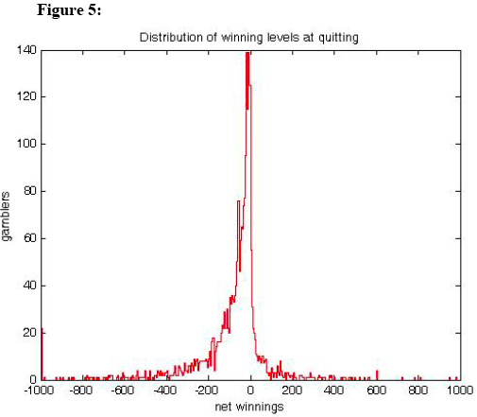
Quitting in casino betting (Lien 09)

Slide 47
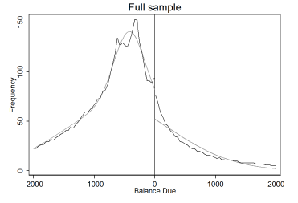
Avoiding paying the IRS (Rees-Jones 2013)
Notes:
Also Engstrom paper…. Those w/ prelim deficit (owing) in sweden more likely to claim extra deductioin. Estimate lambda=2.17

Slide 48
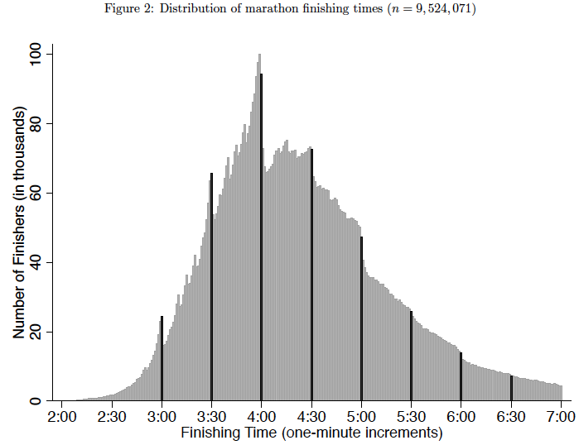
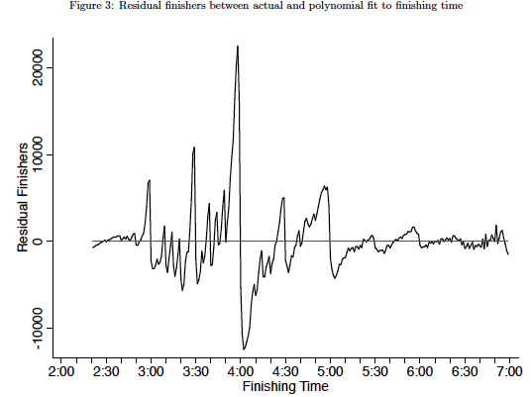
Goal influence in marathon times (Allen, Dechow,Pope Wu 14)
Notes:
Upper right is 15th order polynomial residuals

Slide 49
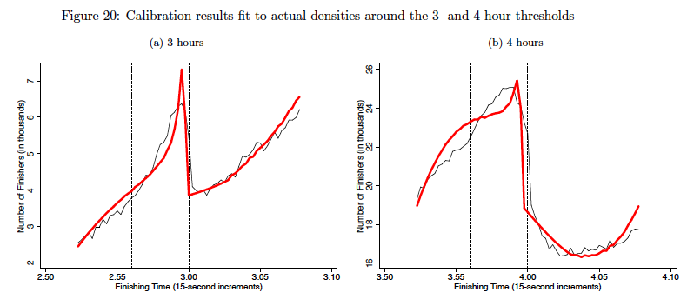
Calibration λ=2.35 p=12% refdep λ=1.77 p=6% refdep

Slide 50
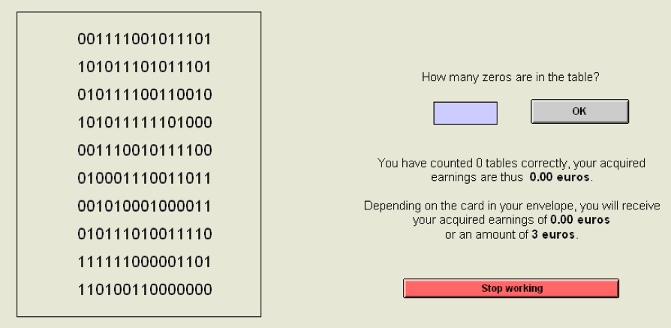
Experimental labor task (Abeler+ AER 11)
Count zeros, earn either .20€ or f (random)

Slide 51
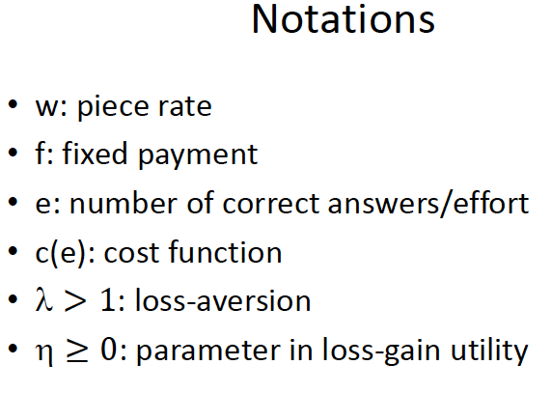

Slide 52
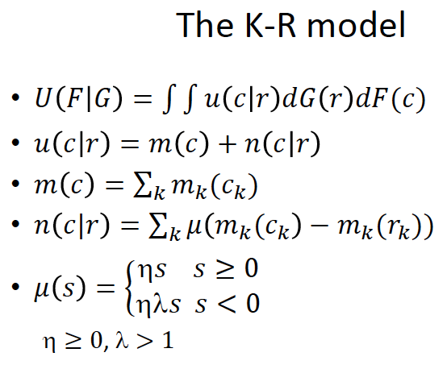
Choice-consistent expectational reference point (Koszegi-Rabin AER 06+)

Slide 53
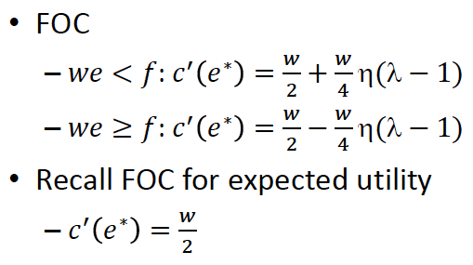
Under KR, stop at we*=f earn more when f=7 vs f=3

Slide 54
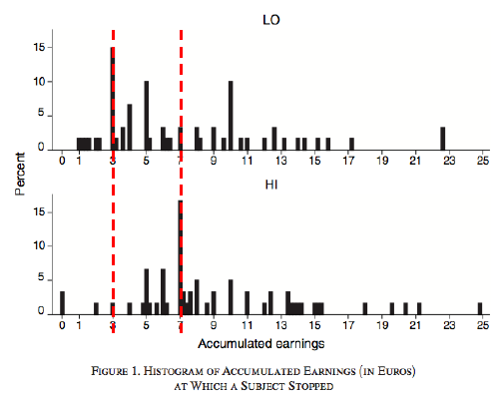
distribution of total earnings

Slide 55


Failures of expectational ref-dependence: Forced exchange with probability p
Selling↑in p, buying ↓in p
(Goette+ 2015 http://papers.ssrn.com/sol3/papers.cfm?abstract_id=2529348)
Notes:
Look carefully here

Slide 56
predictions
p=.5 → no endowment effect x^{sell}(.5)=x^{buy}(.5)
p>.5 → reverse endowment effect
  x^{sell}(p)< x^{buy}(p)
complementary symmetry
    x^{sell}(p)< x^{buy}(1-p)

Slide 57

Notes:
None of the predictions work

Slide 58
theory
Notes:
None of the predictions work

Slide 59

Detail: when do they get mugs & when do they get instructions?
“first focus” on mechanism doesn’t matter random prices don’t matter

Slide 60
Alternative view: Reference points determine focus of attention
Query Theory (Johnson, Weber)
“What should l pay?” answered by queries
  Starting point (+ / -) depends on ref point
  Aspect-listing predicts choice
  Starting point change → choice
Notes:
Passage from other Johnson paper

Slide 61

Example: Endowment fx
Johnson+ JEP:LMC 07

Slide 62

Talk → action

Slide 63

Endowment affects query “start”

Slide 64

Order reverses aspect difference
& erases endowment effect

