Slide 1
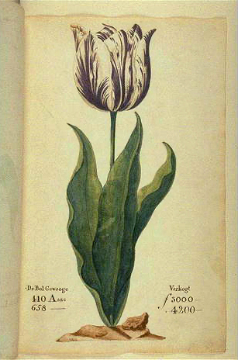
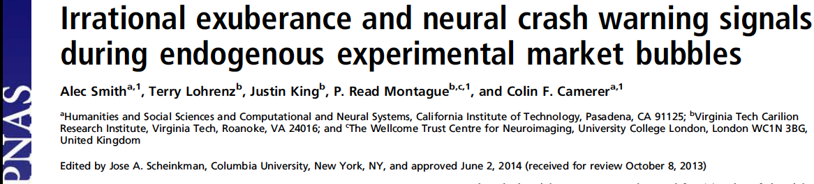


Slide 2
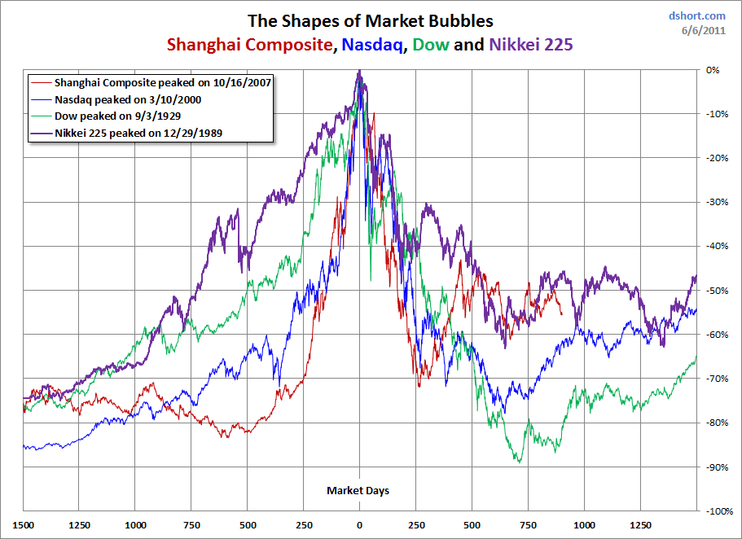

Slide 3
Why study bubbles?
“[An] issue that clearly needs more attention is the formation and propagation of asset price bubbles…I suspect that progress will require careful empirical research with attention to psychological as well as economic factors…I would add that we also don’t know very much about how bubbles stop either…”
  - Ben Bernanke, 2010 speech

Slide 4
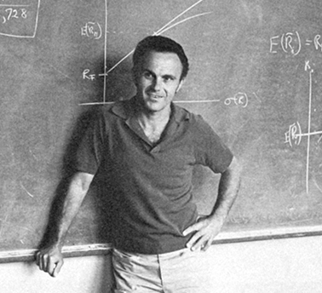
Bubble = Price >> Fundamental
But what is the fundamental?
“I don't even know what a bubble means. These
words have become popular. I don't think they
have any meaning.”
  Eugene Fama (cited in The New Yorker, January 13, 2010)
Notes:
----- Meeting Notes (5/1/13 13:30) -----
Say: even though this definition is mathematical, you can't see the fundamental; what fama is thinking is that if prices are high then the fundamental must be high
There is continued controversy

Slide 5
Many theories
Financial structure & constraint
  speculate on asset float from insider lock-up expiration (Hong, Scheinkman, Xiong 2006 )
  hedge funds (Gennote Leland 90)
  agency conflicts (Allen, Gorton 93)
  credit expansion + risk shifting (Allen, Gale 00)

Slide 6
Many theories (cont’d)
Media coverage
  Dyck, Zingales, 03; Veldkamp, 06; Tetlock, 07; Bhattacharya+ 09
Non-common knowledge or opinion asynchrony
  Allen, Morris, Postlewaite 93; Abreu Brunnermeier, 03
Information processing
  feedback trading (DeLong+ 90)
  overconfidence + short sale constraint (Scheinkman Xiong 03)
  “coarse” updating of market sentiment (Bianchi Jehiel 10)
Experimental design turns off all mechanisms except (endogeneous) information processing

Slide 7
Theories describe neural mechanisms (only) implicitly…
“Another fundamental ingredient of bubble episodes is that market participants become increasingly euphoric and then (some of them) realize they have been invested for too long and panic” (Bianchi Jehiel 2010)

Slide 8

Warren Buffett
“Be fearful when others are greedy, and greedy when others are fearful.”

Slide 9
Connections
Economics Experiments
  Smith, Suchanek, & Williams (1988); Dufwenberg, Lindqvist & Moore (2005); Bostian, Goeree, & Holt (2005); Haruvy & Noussair (2006), Kirchler, Huber, Stockl (2012)
Behavioral Finance
  DeLong, Shleifer, Summers & Waldmann (1990); Abreu & Brunnermeier(2001); Scheinkman & Xiong (2003); Baker & Wurgler(2006,07);
Neuroeconomics
  Kuhnen & Knutson (2005); Preuschoff + (2006,8)

Slide 10
What we do
Create a lab paradigm that reliably generates bubbles and crashes
Measure neural activity using fMRI
Connect neural activity to bubbles and crashes
Notes:
SAY: Neural activity can serve as a biomarker for asset price bubbles
----- Meeting Notes (5/1/13 13:30) -----
Make this leaner in terms of words
cut 1/3 of words
cut out individidual differences
put slide before next one (design)
Preview of results
Take brain picture put it next: What we'll do
Look at brain response to events in the NAcc, see if they predict behavior
A preview: feedback mechanisms

Slide 12
Why care about where? I.
Choice depends on a neural algorithm η
  C(η(S,Θ)) S=choice set Θ=information, prices…
  Choice data: Observe only C(S,Θ)……
  Omitting η(.,.) is vulnerable to a neural “Lucas critique”:
    Effects of S,Θ operate through η(S,Θ)
    Will draw wrong (inefficient) inferences from historical C(S,Θ)
  Example: Suppose there is an inelastic habit mode H(S,Θ)=H(S)
    Choice function is C(η(S,Θ,H))
    H is unobserved in reduced-form non-neural data
    Elasticity estimates would be improved by observing H
Why where? Necessary to pin down a neural habit

Slide 13
Why care about where? II.
Early causality checks are valuable!
  Knowing “where” checks fMRI-based hypothesis
  ROIs are targets of different neurotransmitters, hormones
  Differential human lifecycle development in different regions
  targets for causal stimulation (e.g. TMS, tDCS)
Evidence of function of ROIs makes field predictions
  insula →? selling (this study)
  S → insula (other studies)
  (S)timulus→ insula activity → behavior (possible incidental fx)
  (S)Timulus → behavior (test w/ field data)

Slide 14


Slide 15
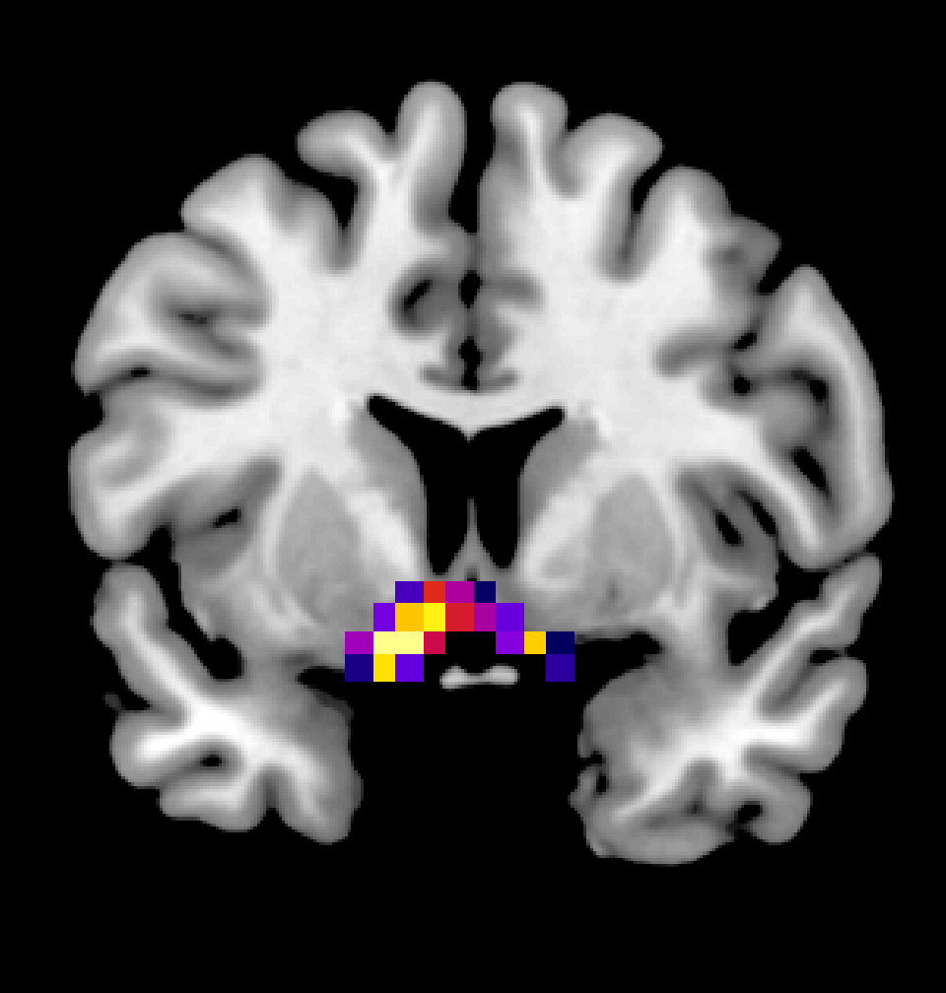
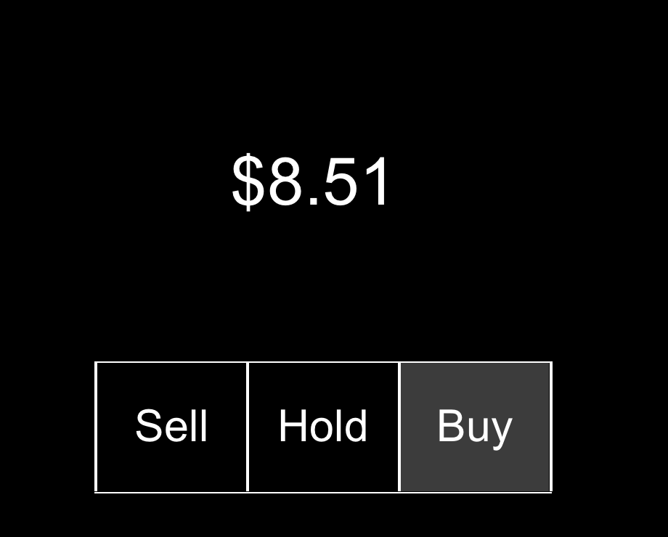
A Neurobehavioral Feedback Mechanism
$27.52

Slide 16
Data Collection
16 sessions
N=11-23/Session
  Mean N=20
  N = 320 Total Participants
  UCLA & Virginia Tech (scanned)
2-3 fMRI Participants/Session
  N=44 total scanned

Slide 17
Market Design (Bostian, Goeree, & Holt 05)
2 assets:
  Risky (“Stock”) lives 50 periods
  Risk-free (“Cash”)
Risky pays uncertain dividend with E(d)
Risk-free pays interest rate r
Risky converts into F units of cash in period 50

Slide 18
Trading
50 trading rounds
Trade 1 unit max per round
Call market design: 1 common price per round

Slide 19
Fundamental Value
Indifferent between safe and risky assets when:

Slide 20
Fundamental Value
Indifferent between safe and risky assets when:

Slide 21
Fundamental Value
Indifferent between safe and risky assets when:

Slide 22
Fundamental Value
Indifferent between safe and risky assets when:

Slide 23
Fundamental Value
Indifferent between safe and risky assets when:
Choose parameters:

Slide 24
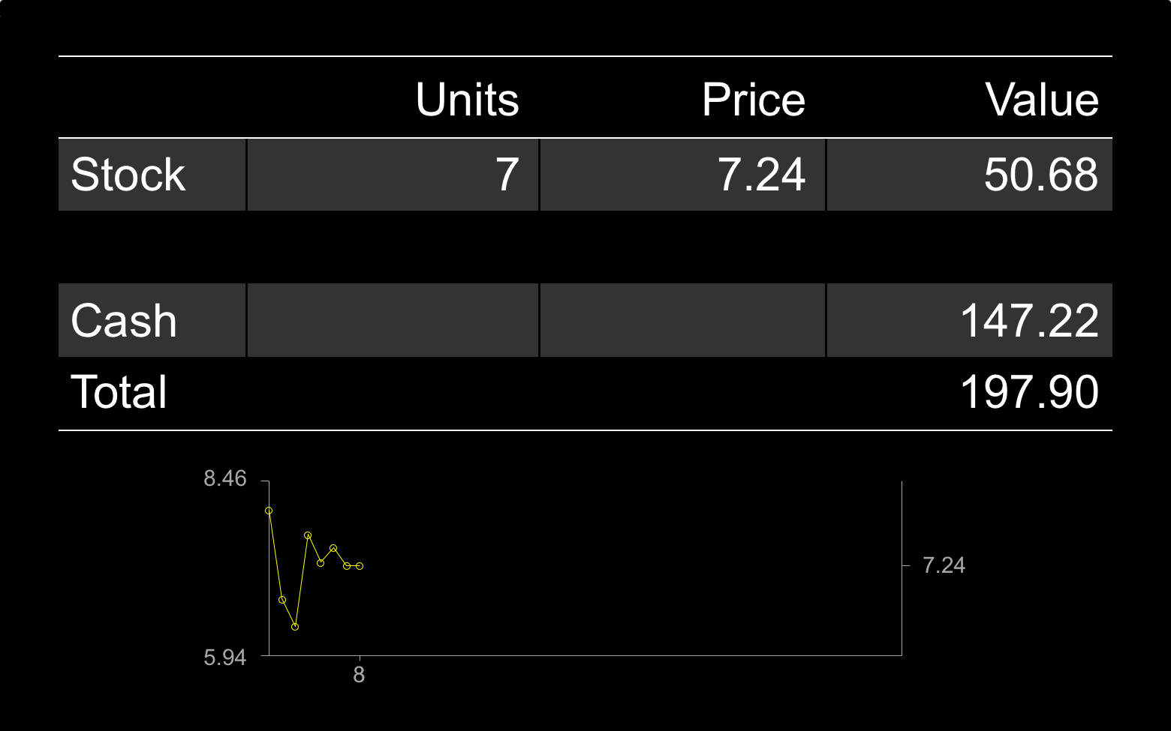
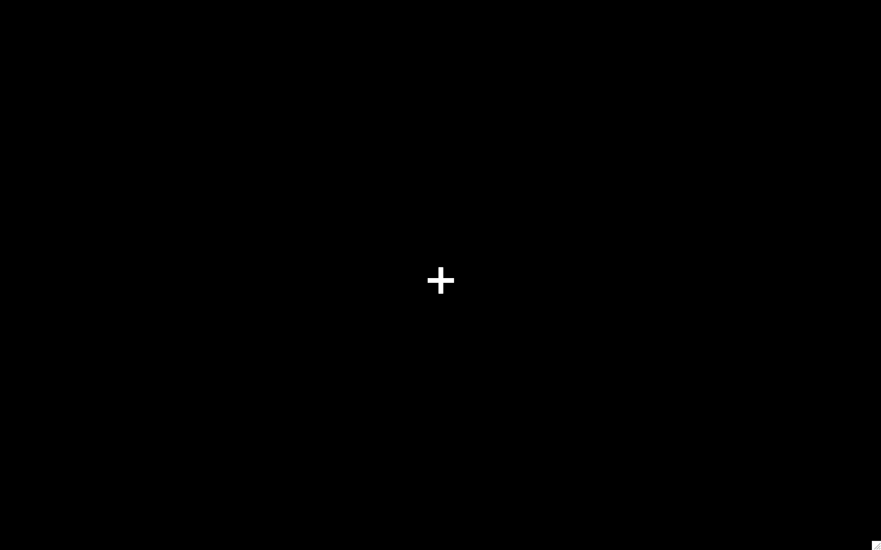
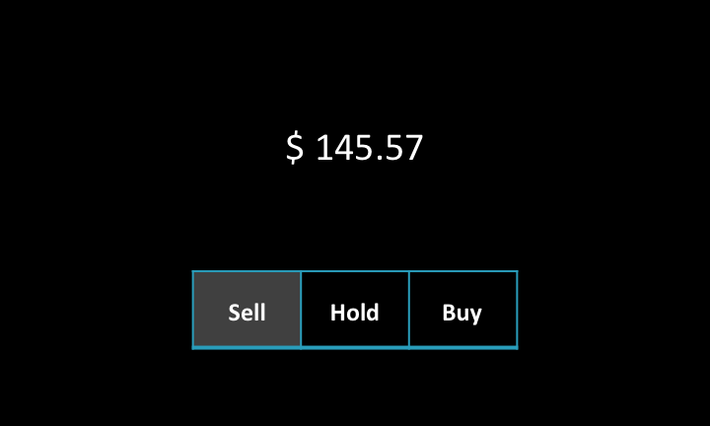

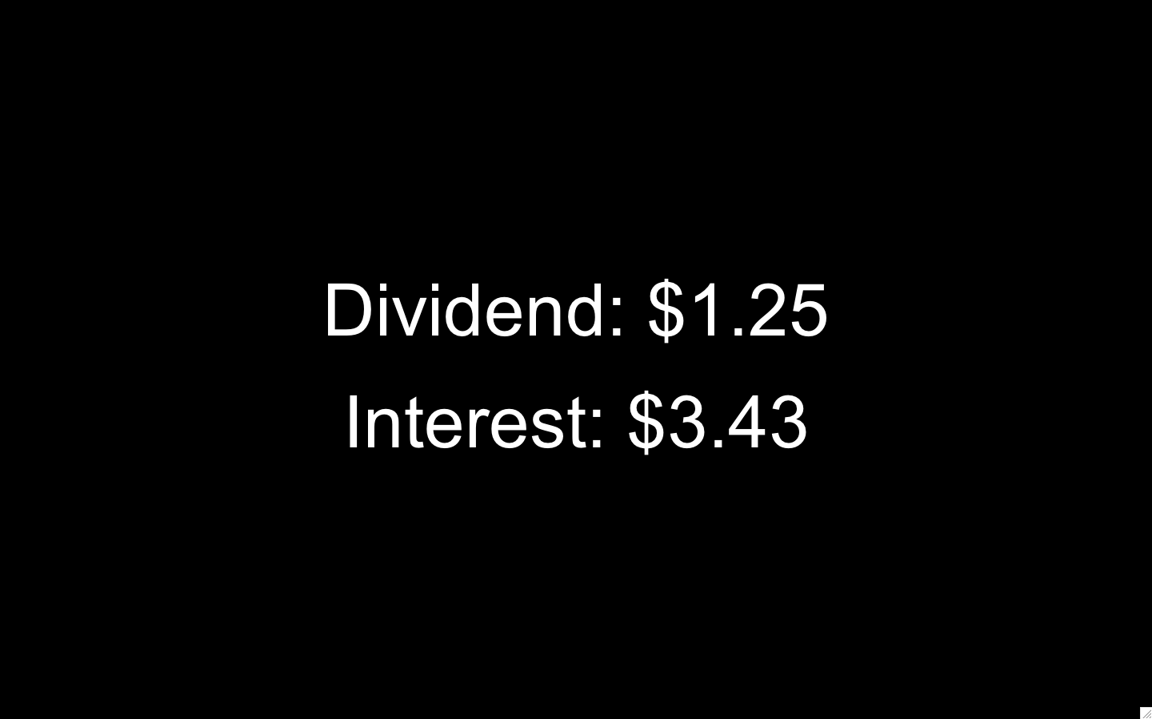
A)
6s
B)
1.25(P_{t-1})
Randomly Drawn Stimulus
Price
1-7s
P_{t-1}
2s (x5)
1-7s
0.75(P_{t-1})
2s
C)
10s
Market
Price
2s
10s

Slide 25
Orders
5 pseudorandom prices each round
Subjects respond Sell, Hold or Buy
Orders are highest Buy, lowest Sell
1.25(P_{t-1})
35.42
P_{t-1}
0.75(P_{t-1})

Slide 26
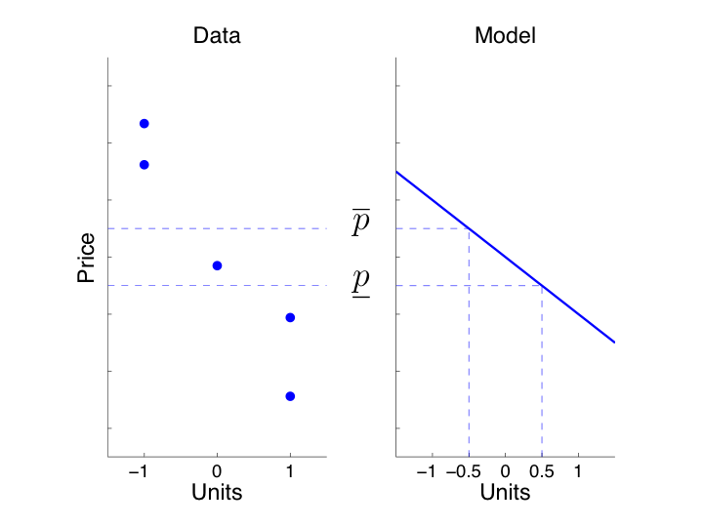
Demand for the risky asset

Slide 27
How the price is set
(“market clearing”)
Call market matches buy and sell orders each round
  Single price
  Closed book

Slide 28

Trading Results (2s): Sole focus of fMRI analysis (so far)

Slide 29
SExpFin audience
What will happen?
  Few bubbles
  Bubbles in most sessions
  No bubbles
  No guess

Slide 30
Agents’ forecasting problem at period 25: How long will a bubble last?

Slide 31
Market Prices, 16 Sessions

Slide 32
Market Prices, 16 Sessions

Slide 33
Example Session

Slide 34
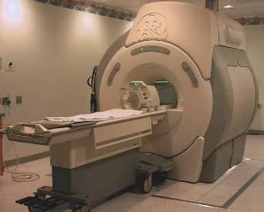
Source: Scott Huettel

Slide 35
functional Magnetic Resonance Imaging (fMRI)
Measures blood oxygenation level dependent (BOLD) signal
In small (4mm³) regions of the brain called voxels
About 25,000 voxels
We capture a whole brain image every 2s

Slide 36
Our market neuroscience empirical strategy
Look for reward & risk-related signals
  GLM across all people, trials, sessions
  Identify NAcc(umbens)
    Look at NAcc moving average & prices (all sessions)
    Look at NAcc regression on individual buying (with controls)
    Look at NAcc-buying sensitivity across people
  A priori focus on insula (risk, variance)
    Look at path of insula activity for high & low $ traders
    Look at insula-selling sensitivity across people

Slide 37
Empirical neural analysis strategy: Overview
GLM at time of trade result screen
ROI analysis of Nucleus Accumbens
  Group: “event study” around peak
  Does NAcc predict (“lead”) buying?
  Individual differences in brain-buying sensitivity
a priori ROI analysis of anterior Insula
  Earnings-group differences around peak
  Does Ins predict (“lead”) selling?
  Individual differences in brain-selling sensitivity

Slide 38
GLM results
y=8
y=8
y=8
BOLD Responses to
Buying or selling
Peak T statistics
(FWE whole brain corrected<.05)
Left: 7.69
Right: 7.09
MNI +/- 12,8,-10
Controls:
Screen Indicators
Return, Div Yield
Nucleus Accumbens
p<0.05
p<5e-6

Slide 39
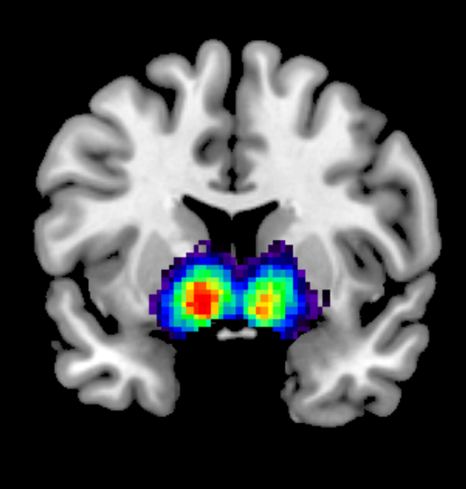
y=8
y=8
Conjunction of BOLD responses to
Buy and Sell
y=8
203 fMRI studies
Keyword “REWARD”
Neurosynth reverse inference
y=8
y=8
y=8
p<0.05
p<5e-6

Slide 40
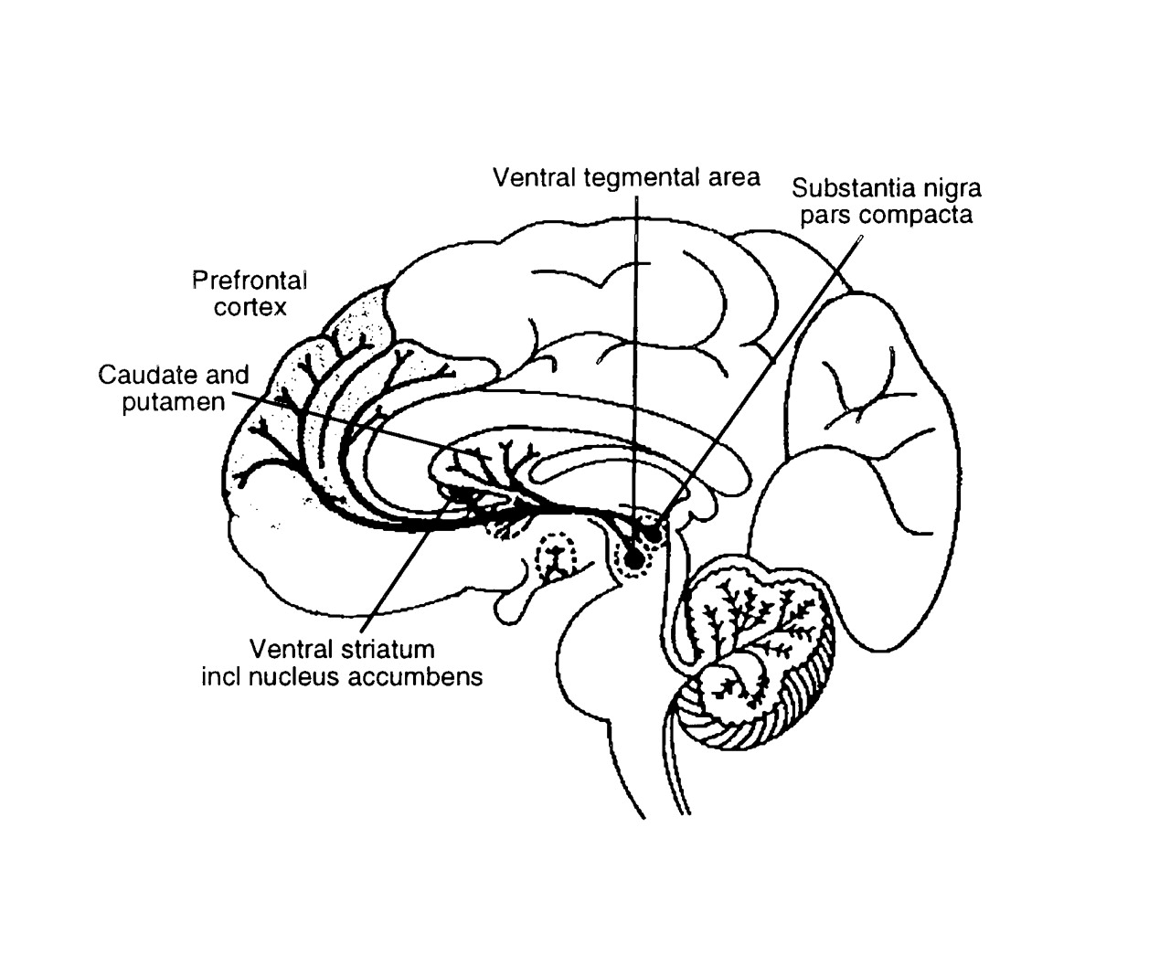

Overview of the projection territories of midbrain dopamine neurons.
Schultz W Physiology 1999;14:249-255
©1999 by American Physiological Society
Notes:
Overview of the projection territories of midbrain dopamine neurons. Cell bodies of dopamine neurons are located mainly in the pars compacta of substantia nigra and the medially adjoining ventral tegmental area. Their axons project mainly to the striatum (caudate nucleus, putamen), ventral striatum including nucleus accumbens, and frontal cortex (dorsolateral, ventrolateral and orbital prefrontal cortex). Dopamine is released from axon terminals with impulses and influences neurons in these structures. Our experiments investigate the impulse activity at the level of dopamine cell bodies.

Slide 41
The Dopaminergic Reward System
Midbrain dopamine (DA) neurons encode reward prediction errors
  Montague, Dayan, Sejnowski (1996) J Neuro; Schultz, Dayan, Montague (1997) Science
DA neurons project to NAcc
NAcc BOLD reflects DA levels
  Knutson Gibbs (2007) Psychopharmacology
DA therapy makes Parkinson’s patients more sensitive to gains in learning tasks (+ 17% pathological gambling)
  Frank et al (2004) Science; Voon et al. (2010) Neuron

Slide 42
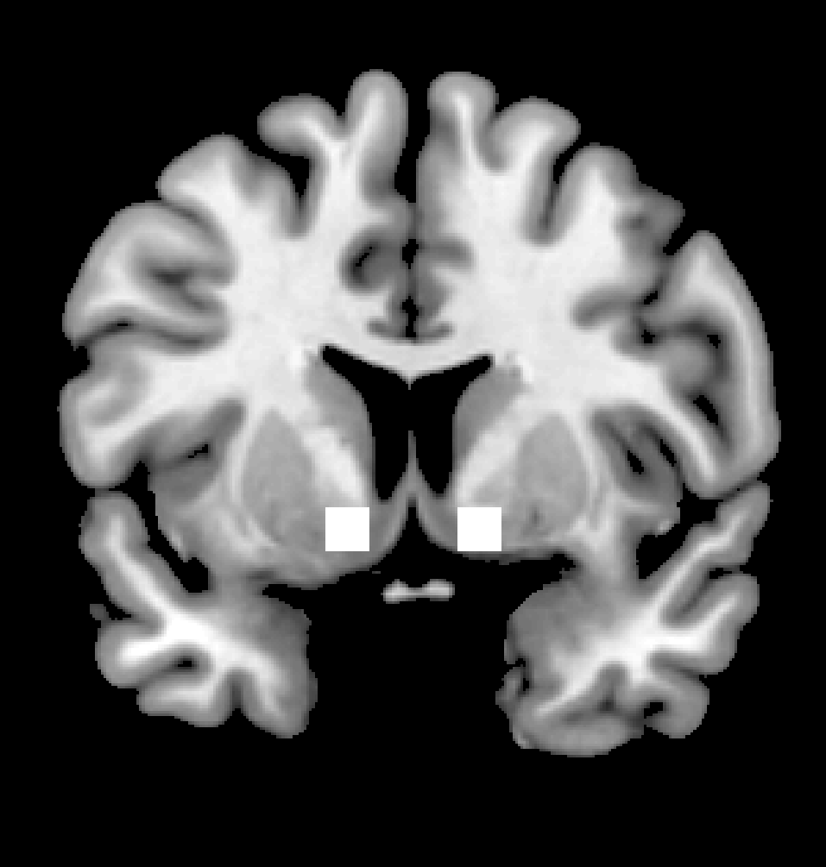
ROI analysis
Nucleus Accumbens
A Priori Mask
MNI (+/-12,8,-8)
24 voxels total
Trial-by-trial peak response to “Trading Results”

Slide 43
NAcc by Price and Trade
**
***
** p<0.01
*** p<0.001

Slide 44
t-stat > 3.0

Slide 46
Three trader-profit types

Slide 47
NAcc by Subject Earnings

Slide 48
Neurobehavioral metrics
(a) Does neural activity predict trading in next round?
Individual differences in (a)
Compare to task performance

Slide 49
Determinants of Demand for the Risky Asset: Interval regressions Dependent variable is [buy_{max}, sell_{min}] (in returns)
All variables lagged; z-scored except shares, dummy
NAcc | 0.008 |  | 0.011**
 | (0.005) |  | (0.005)
Return |  | 0.026*** | 0.028***
 |  | (0.009) | (0.009)
Dividend Yield |  | 0.022* | 0.021
 |  | (0.013) | (0.013)
Constant | 1.000*** | 1.001*** | 1.002***
Subject FE | Yes | Yes | Yes
Cluster level | Subject | Subject | Subject
*** p<0.01, ** p<0.05, * p<0.1. Robust standard errors in parentheses.

Slide 50
Determinants of Demand for the Risky Asset: Interval regressions Dependent variable is [buy_{t}, sell_{t}] (in returns)
All variables lagged; z-scored except shares, dummy
NAcc | 0.008 |  | 0.011** | -0.001
 | (0.005) |  | (0.005) | (0.005)
Low Earns*NAcc |  |  |  | 0.037***
 |  |  |  | (0.011)
Return |  | 0.026*** | 0.028*** | 0.020**
 |  | (0.009) | (0.009) | (0.009)
Dividend Yield |  | 0.022* | 0.021 | 0.047**
 |  | (0.013) | (0.013) | (0.023)
Shares |  |  |  | yes***
Shares=0 (Indicator) |  |  |  | n.s.
Constant | 1.000*** | 1.001*** | 1.002*** | 0.908***
Low Earns (Indicator) |  |  |  | 0.056***
Subject FE | Yes | Yes | Yes | Yes
5 round dummies | No | No | No | Yes
Cluster level | Subject | Subject | Subject | Subject
*** p<0.01, ** p<0.05, * p<0.1. Robust standard errors in parentheses.

Slide 51
Determinants of Demand for the Risky Asset: Interval regressions Dependent variable is [buy_{t}, sell_{t}] (in returns)
All variables lagged; z-scored except shares, dummy
NAcc |  | 0.008 |  | 0.011** | -0.001 | 0.002
 |  | (0.005) |  | (0.005) | (0.005) | (0.005)
Low Earns*NAcc |  |  |  |  | 0.037*** | 0.026***
 |  |  |  |  | (0.011) | (0.009)
Return |  |  | 0.026*** | 0.028*** | 0.020** | 0.001
 |  |  | (0.009) | (0.009) | (0.009) | (0.008)
Dividend Yield |  |  | 0.022* | 0.021 | 0.047** | 0.039**
 |  |  | (0.013) | (0.013) | (0.023) | (0.016)
buy-sell midpoint (t-1) |  |  |  |  |  | 0.079***
 |  |  |  |  |  | (0.012)
Shares |  |  |  |  | yes*** | yes*
Shares=0 (Indicator) |  |  |  |  | n.s. | n.s.
4 ROIs: rAIns,Amyg,rTPJ,lDLPFC |  |  |  |  |  | n.s.
Constant | 1.000*** |  | 1.001*** | 1.002*** | 0.908*** | 0.932***
Low Earns (Indicator) |  |  |  |  | 0.056*** | 0.062***
Subject FE | Yes |  | Yes | Yes | Yes | Yes
5 round dummies | No |  | No | No | Yes | Yes
Cluster level | Subject |  | Subject | Subject | Subject | Subject
*** p<0.01, ** p<0.05, * p<0.1. Robust standard errors in parentheses.

Slide 52
Determinants of Demand for the Risky Asset: Interval regressions Dependent variable is [buy_{t}, sell_{t}] (in returns)
All variables lagged; z-scored except shares, dummy
NAcc |  |  |  |  | -0.001 | 0.002
 |  |  |  |  | (0.005) | (0.005)
Low Earns*NAcc |  |  |  |  | 0.037*** | 0.026***
 |  |  |  |  | (0.011) | (0.009)
Return |  |  |  |  | 0.020** | 0.001
 |  |  |  |  | (0.009) | (0.008)
Dividend Yield |  |  |  |  | 0.047** | 0.039**
 |  |  |  |  | (0.023) | (0.016)
buy-sell midpoint (t-1) |  |  |  |  |  | 0.079***
 |  |  |  |  |  | (0.012)
Shares |  |  |  |  | yes*** | yes*
Shares=0 (Indicator) |  |  |  |  | n.s. | n.s.
 |  |  |  |  |  | n.s.
Constant |  |  |  |  | 0.908*** | 0.932***
Low Earns (Indicator) |  |  |  |  | 0.056*** | 0.062***
Subject FE |  |  |  |  | Yes | Yes
5 round dummies |  |  |  |  | Yes | Yes
Cluster level |  |  |  |  | Subject | Subject
*** p<0.01, ** p<0.05, * p<0.1. Robust standard errors in parentheses.
“Exuberance”

Slide 53
“Irrational exuberance” & profits
NAcc-Buying association

Slide 54
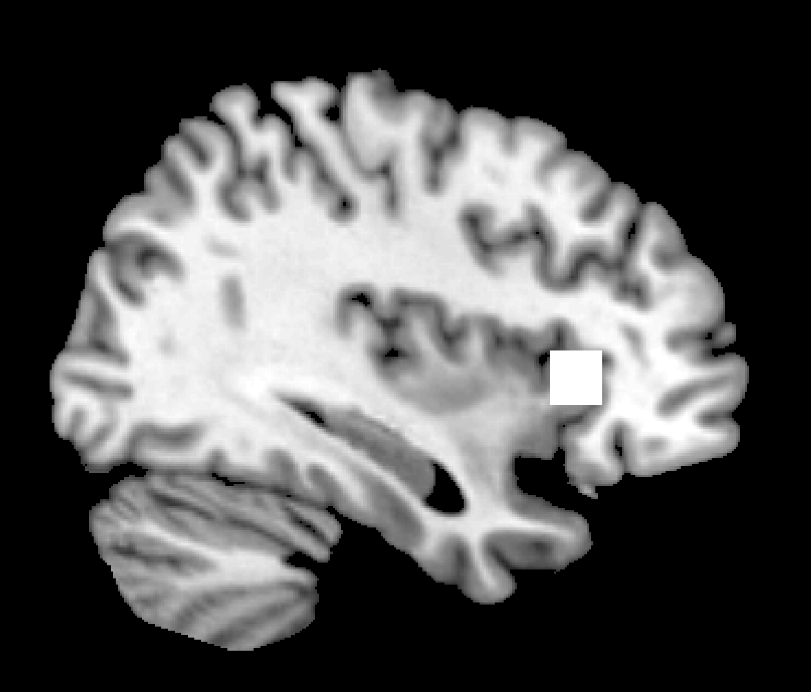
ROI analysis of uncertainty
Anterior Insula (Right)
A Priori Mask
MNI (36,24,2)
Preuschoff, Quartz & Bossaerts 2008
prediction eror variance

Slide 55
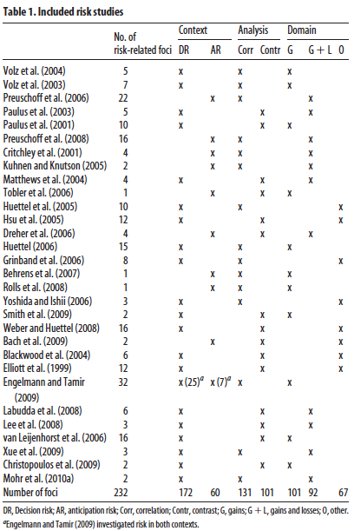
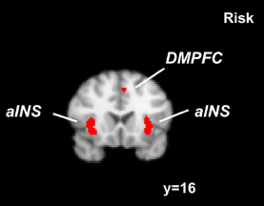
Insula “encodes” risk: ALE aggregation of 33 studies (Mohr+ JN 10)

Slide 56
-20
-10
0
10
20
Rounds after peak

Slide 58
Stronger insula-selling coefficients are associated with more $
rAIns-Selling association

Slide 59
Conclusion: Why care about where?
Individual differences (gray matter volume etc.)
Cross-method predictions check fMRI-based hypothesis:
  ROIs are targets of different neurotransmitters, hormones
  Differential human development in different regions
  targets for causal stimulation (e.g. TMS, tDCS)
Evidence of function of ROIs makes field predictions
  insula →? selling (this study)
  S → insula (other studies)
  (S)timulus→ insula activity → behavior (possible incidental fx)
  (S)Timulus → behavior (test w/ field data)

Slide 60
Discussion: NAcc
We connect bubble buying to NAcc
NAcc involved in drug addiction and behavioral disorders e.g. compulsive gambling
Think about bubbles as a collective behavioral pathology
Common biological foundations with addiction and impulse control disorders

Slide 61
Discussion: Insula
We find evidence for a neural “early warning” signal in the right anterior insula
Insula activity associated with awareness of bodily states, pain, risk, gut feelings & emotion
Suggests causal changes that increase insula activity could reduce bubbles

Slide 62
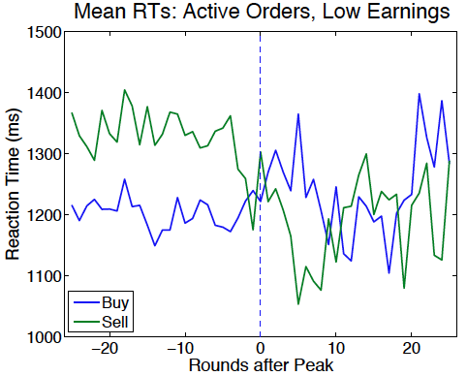
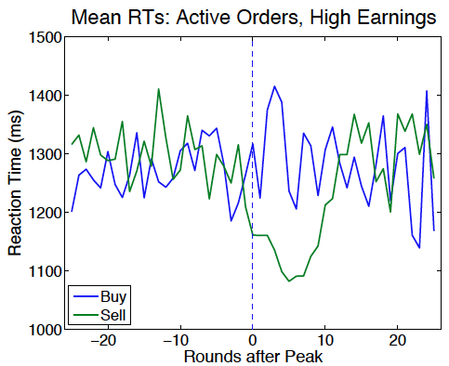
Bonus finding 1: Fast buying is associated with poor performance
Buy RT << Sell RT

Slide 63
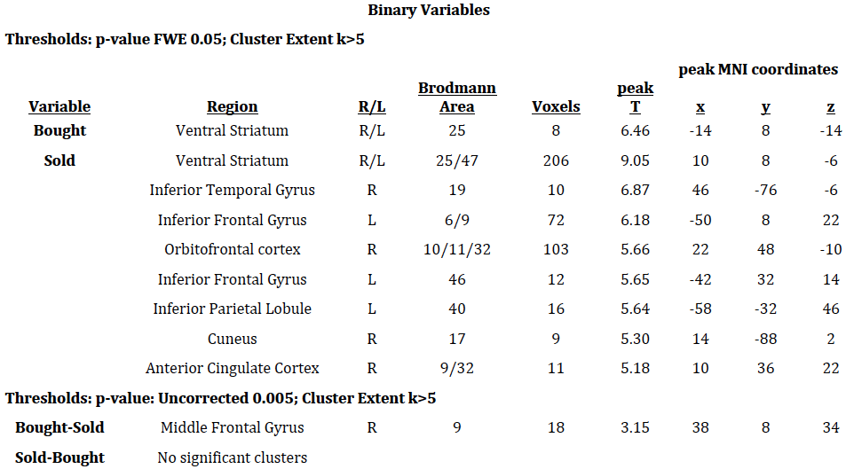
Bonus finding 2: Stronger neural response to SOLD than to BOUGHT

Slide 64
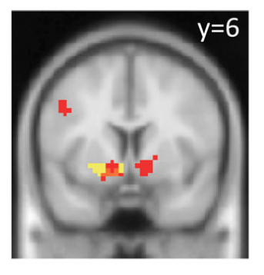
Encoding “realization utility” from selling for capital gain (Frydman, Camerer, Barberis, Rangel JF in press)
Notes:
(red) VStr in selling for cap gains versus holding (p<.001)

Slide 65
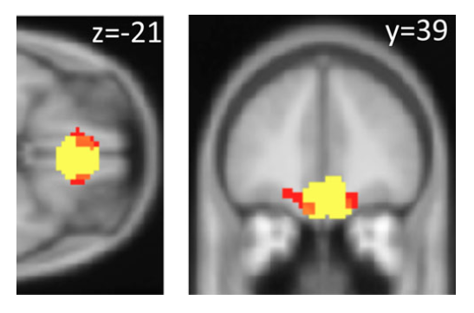
In this study, selling activates a similar OFC region (x=22, y=48, z=-10)
Notes:
Red is coeff beta_2 Shown at p<.001 but FWE <.05 in paper Yellow is mask.

Slide 66
Bonus finding 3: Trading strategies based on (historical) prices only
Price changes are generally monotonic with one turning point
Policy:
  Buy 1 share/period until k*, then sell
  What is optimal k*?
Method: Search for optimal k* in N-1 markets (training); how well does k* do Nth market (holdout)?
  Do this for all 16 markets, each held out once

Slide 67
Do 48% better than average S; training result is 94% of within-market “clairvoyance”
K* (holdout) | Subject earnings | Earnings K*(holdout) | K* (within-market) | Earnings K*(within-market) | % improvement (holdout) | K*(holdout)/K*(within market)
13 | 2142 | 2388 | 19 | 2462 | 0.15 | 0.97
13 | 2030 | 3609 | 11 | 3705 | 0.83 | 0.97
13 | 2087 | 2428 | 10 | 2556 | 0.22 | 0.95
13 | 2064 | 2263 | 9 | 2284 | 0.11 | 0.99
13 | 2107 | 2464 | 15 | 2478 | 0.18 | 0.99
14 | 2149 | 4527 | 8 | 5739 | 1.67 | 0.79
13 | 2022 | 3240 | 14 | 3240 | 0.60 | 1.00
13 | 2098 | 3051 | 13 | 3051 | 0.45 | 1.00
13 | 2169 | 3680 | 11 | 3724 | 0.72 | 0.99
12 | 2032 | 4655 | 17 | 5602 | 1.76 | 0.83
13 | 2103 | 4077 | 14 | 4078 | 0.94 | 1.00
13 | 1996 | 2359 | 16 | 2450 | 0.23 | 0.96
13 | 2136 | 2496 | 14 | 2514 | 0.18 | 0.99
13 | 2084 | 2355 | 20 | 2987 | 0.43 | 0.79
13 | 2070 | 2552 | 12 | 2595 | 0.25 | 0.98
13 | 2089 | 3335 | 12 | 3339 | 0.60 | 1.00
overall
13.00 | 2086 | 3092 | 13.44 | 3300 | 0.48 | 0.94
Notes:
Next– repeat this exercise with *all* data– response times, brain data using LASSO etc.

Slide 69
“Be fearful when others are greedy...”

Slide 70
Collaborators + support:
Moore Foundation, NSF, Lipper Family Foundation, GCOE (Tamagawa), BNE Discovery Fund
Caltech
  Ralph Adolphs
  Peter Bossaerts
  Min Kang
  Gidi Nave
  John O’Doherty
  Antonio Rangel
  Shin Shimojo
Alec Smith
Romann Weber
Berkeley
Teck Ho
Ming Hsu
Natl Univ Singapore
Kuan Chong
USC
Isabelle Brocas
Juan Carrillo
Kyoto
Hidehiko Takahashi
Mikiko Yamada
Tamagawa
Keise Izuma
Kenji Matsumoto
Ryuta Aoki
Magdeburg
Claudia Brunnerlieb
Bodo Vogt
Baylor
  Meghana Bhatt
  Terry Lohrenz
  Read Montague
National Taiwan University
Joseph Wang
NYU
  Peter Sokol-Hessner
  Elizabeth Phelps
Pittsburgh
Stephanie Wang
Rutgers
  Mauricio Delgado
Stanford
Doug Bernheim
Dan Knoepfle
Stockholm School of Economics
Robert Ostling
UCL
Benedetto De Martino
Zurich
  Ian Krajbich
  Kyoto PRI
  Chris Martin
  Tetsuro Matsuzawa

Slide 71
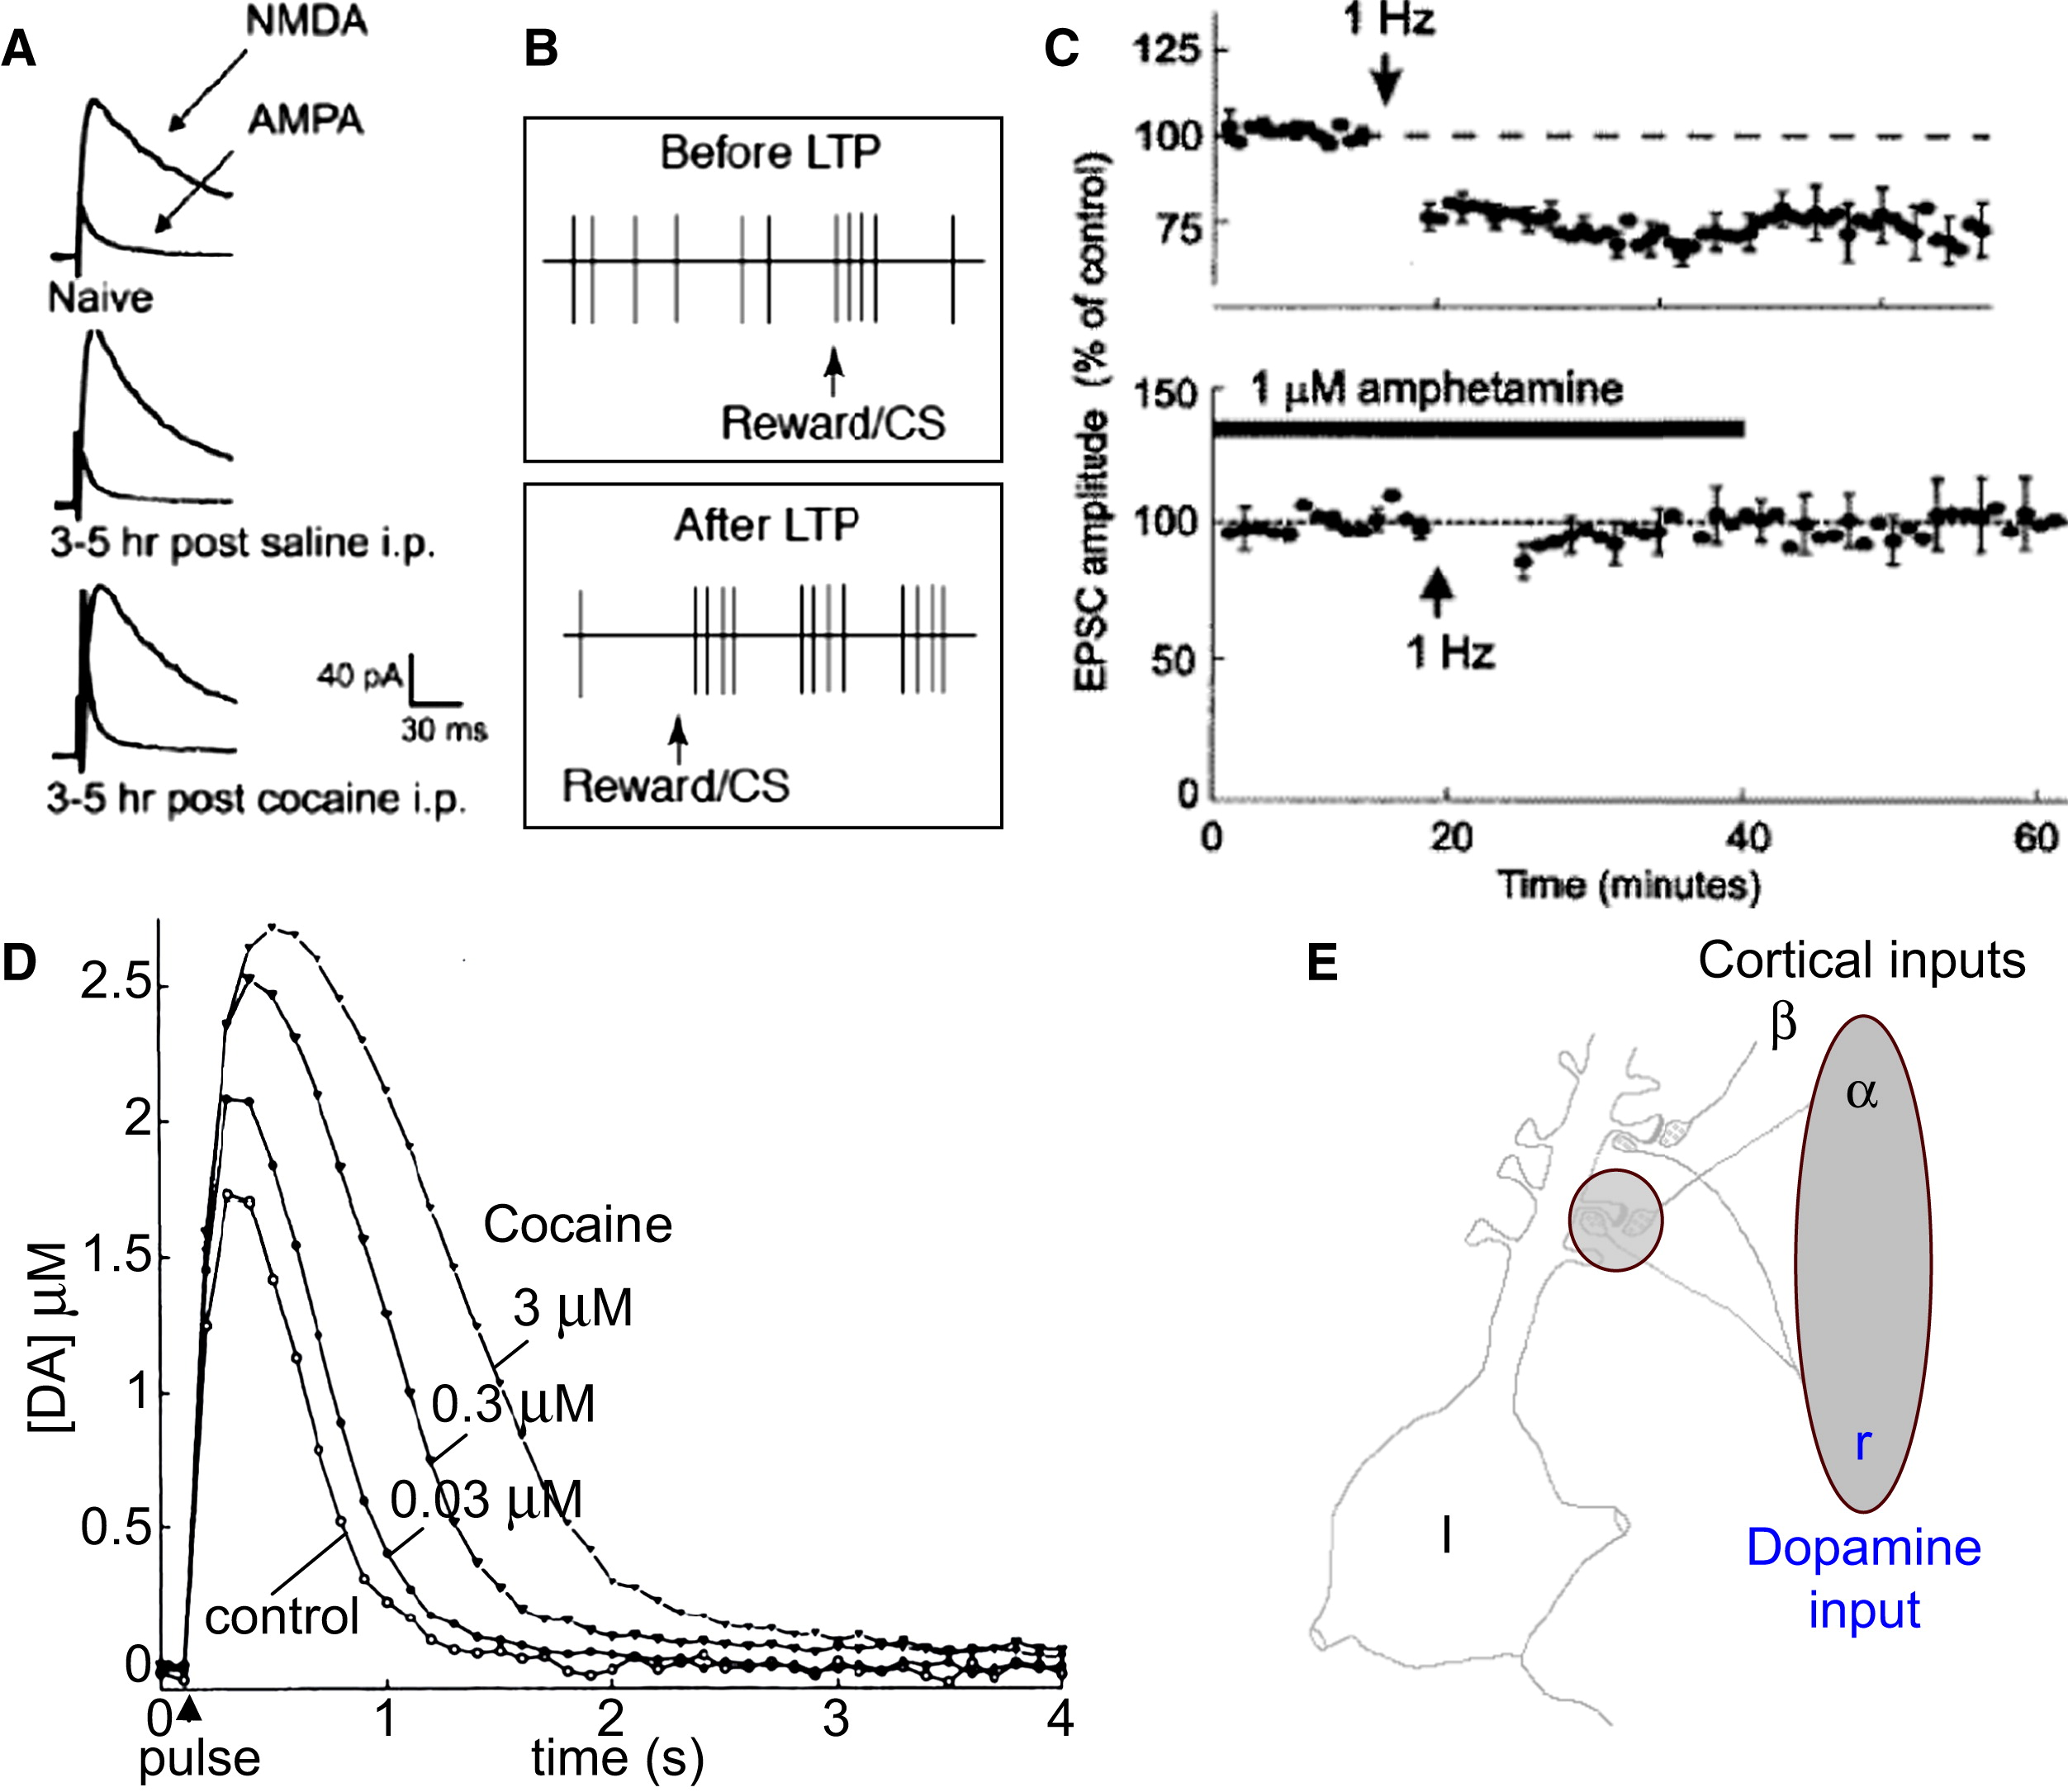
Neuron Volume 69, Issue 4 2011 603 - 617

Slide 72
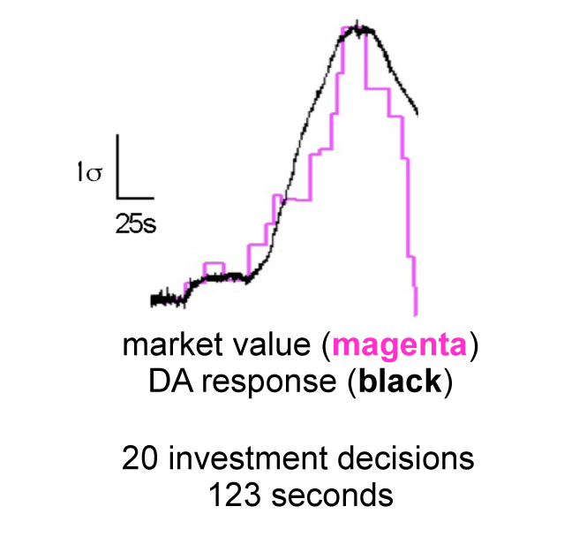
Notes:
Kishida 2011 S1

Slide 73
“Technology has changed, the height of humans has changed, and fashions have changed. Yet the ability of governments and investors to delude themselves, giving rise to periodic bouts of euphoria that usually end in tears, seems to have remained a constant.”
  – Reinhart & Rogoff (2009), This Time is Different

Slide 74
Additional Material

Slide 75
Why Bubbles?
“[An] issue that clearly needs more attention is the formation and propagation of asset price bubbles…I suspect that progress will require careful empirical research with attention to psychological as well as economic factors…I would add that we also don’t know very much about how bubbles stop either…”
  - Ben Bernanke, 2010 speech

Slide 76
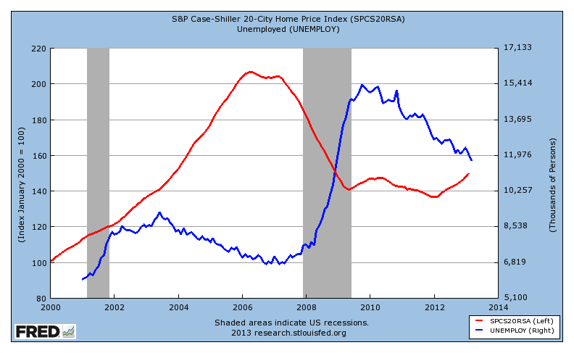
The Housing Bubble and Unemployment
Notes:
The red line shows the 20-city Case Shiller housing price index, starting in 2000
The blue line shows the US unemployment rate
----- Meeting Notes (5/1/13 13:30) -----
This should be titled the housing bubble
This shows that bubbles have costs

Slide 77
Orders
5 pseudorandom prices each round
Subjects respond Sell, Hold or Buy
Orders are highest Buy, lowest Sell
1.25(P_{t-1})
35.42
P_{t-1}
0.75(P_{t-1})

Slide 78
Demand for the risky asset

Slide 79
Market Clearing
Call market matches buy and sell orders each round
  Single price
  Closed book

Slide 80
NAcc by Subject Earnings

Slide 81
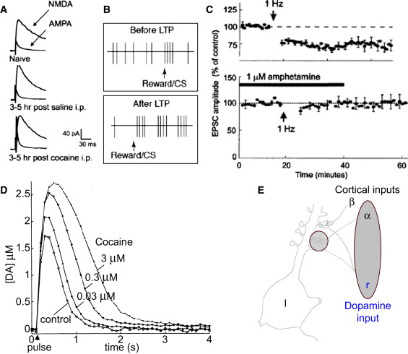
Figure?1 Actions of Addictive Drugs on Dopamine Processes (A) Long-term potentiation in ventral tegmental dopamine neurons in?vitro induced by cocaine. Note the increase in AMPA excitatory postsynaptic current (EPSC) following systemic cocaine (bottom). F...
Wolfram Schultz
Potential Vulnerabilities of Neuronal Reward, Risk, and Decision Mechanisms to Addictive Drugs
Neuron Volume 69, Issue 4 2011 603 - 617
http://dx.doi.org/10.1016/j.neuron.2011.02.014

Slide 82
Neuron Volume 69, Issue 4 2011 603 - 617

Slide 83
Notes:
Kishida 2011 S1

